Slide 1
Waldo_Summer 2018
Plots slides: *wo = without the 1st block
2-6: ‘wo’ Group Averages & poster plots
7-11: full dataset Group Averages plots
12-20: Noticed or Not
21: SPSS stats for Notice or Not
22-30: Used or Not
31-35: *
36: Notice or not & Used or not -3 sub-groups SPSS analysis
37: AQ correlation in races
38-46: Eye data availability
47: SPSS states for Eye Data
48-56: Feature Finding (Serial search)
57-65: Position Memorization (Serial search)
66-74: Search Pattern (Serial search)

Slide 2
Group Averages
Without the 1st Block

Slide 3
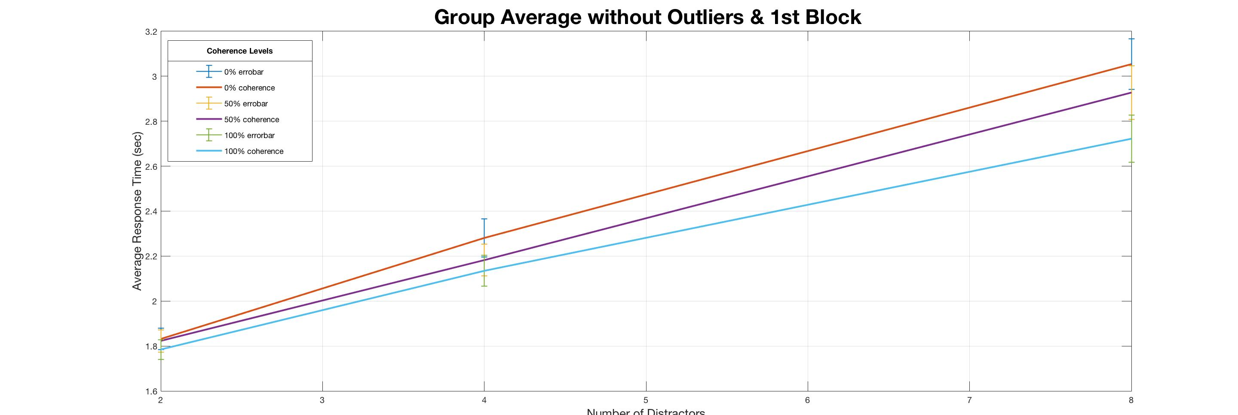
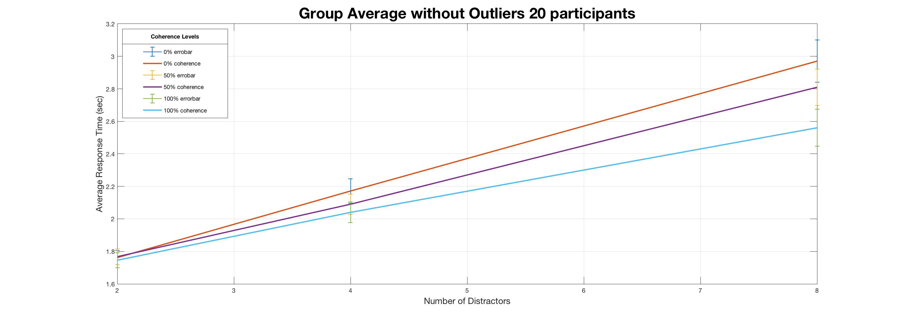
distractor F(1.07, 37.28) = 249.16, p<0.001
coherence F(2, 70) = 34.16, p<0.001
distractor*coherence F(2.95, 103.09) = 9.89, p<0.001
distractor F(1.05, 19.88) = 157.07, p<0.001
coherence F(2, 38) = 24.33, p<0.001
distractor* coherence F(4, 76) = 11.57, p<0.001

Slide 4
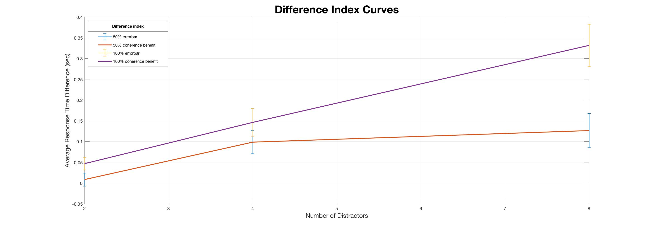
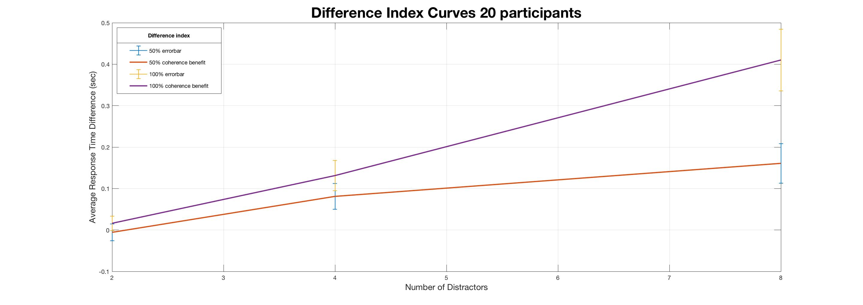
no. of distractors F(1.72, 60.23) = 13.97, p<0.001
benefit index F(1, 35) = 18.47, p<0.001
no. of distractor*benefit index F(1.45, 50.88) = 6.82, p = 0.06
no. of distractors F(2, 38) = 18.48, p<0.001
benefit index. F(1, 19) = 15.70, p<0.001
no. of distractor*benefit index F(1.55, 38) = 7.0, p = 0.006

Slide 5
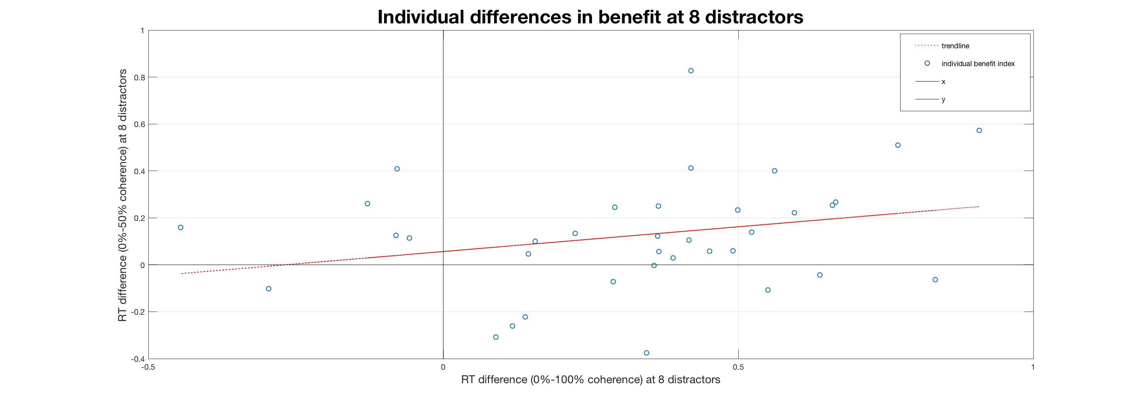
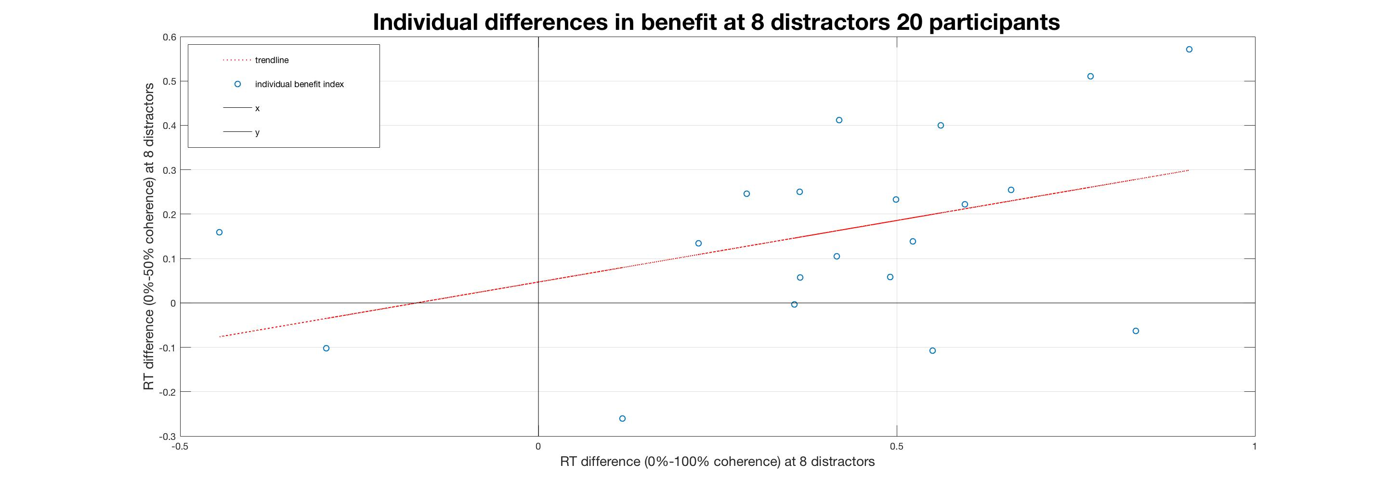
r(34) = 0.26, p = 0.12
r(18) = 0.43, p = 0.06

Slide 6
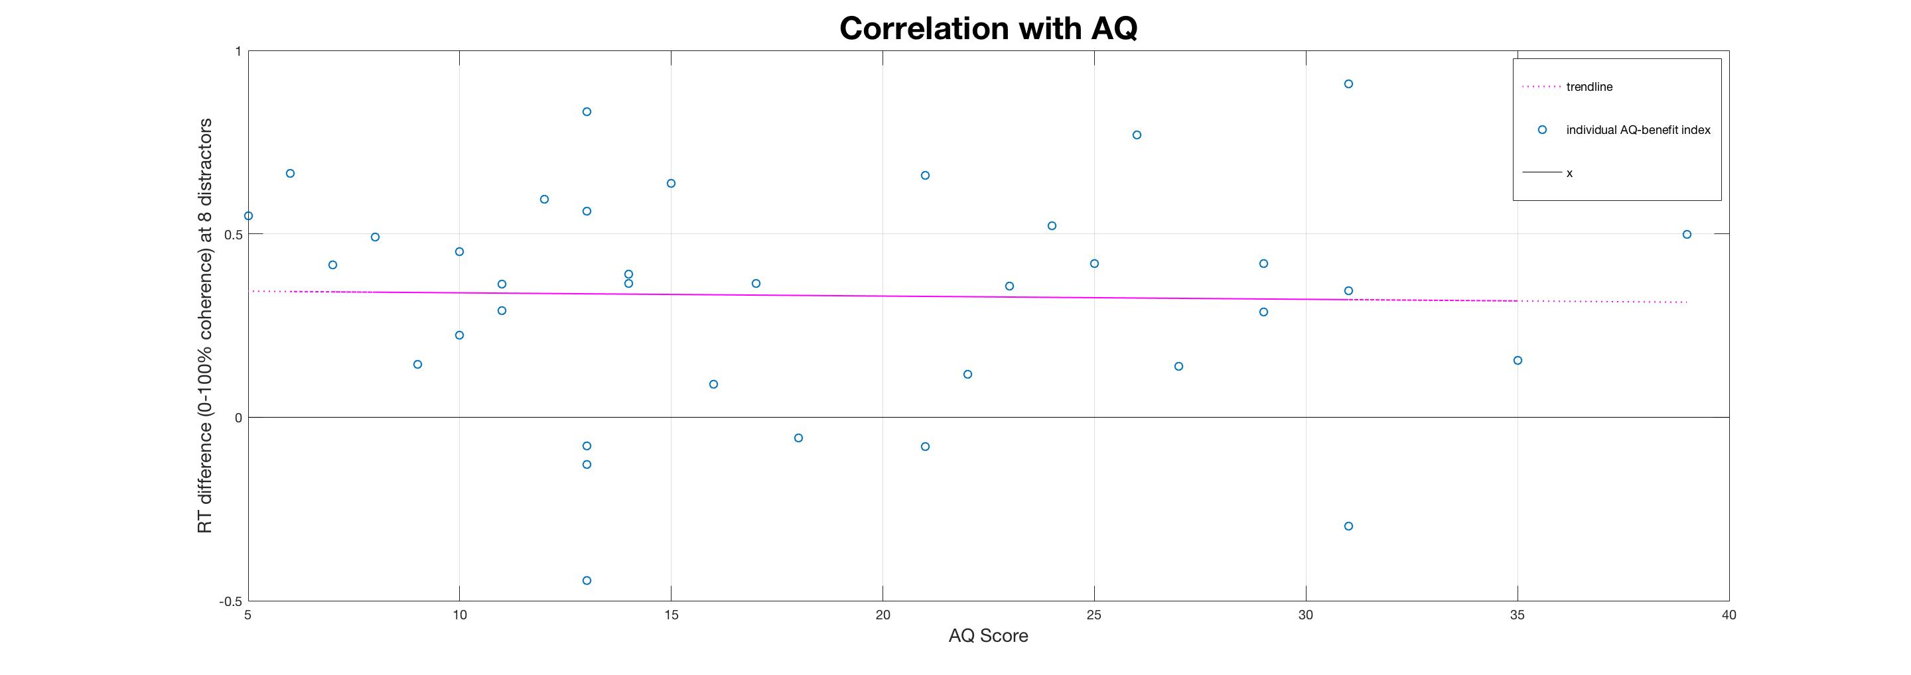
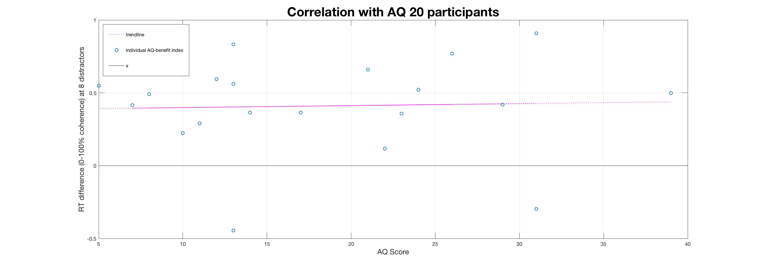
r(34) = -0.26, p = 0.88
r(18) = 0.039, p = 0.87

Slide 7
Group Averages
With the 1st Block

Slide 8
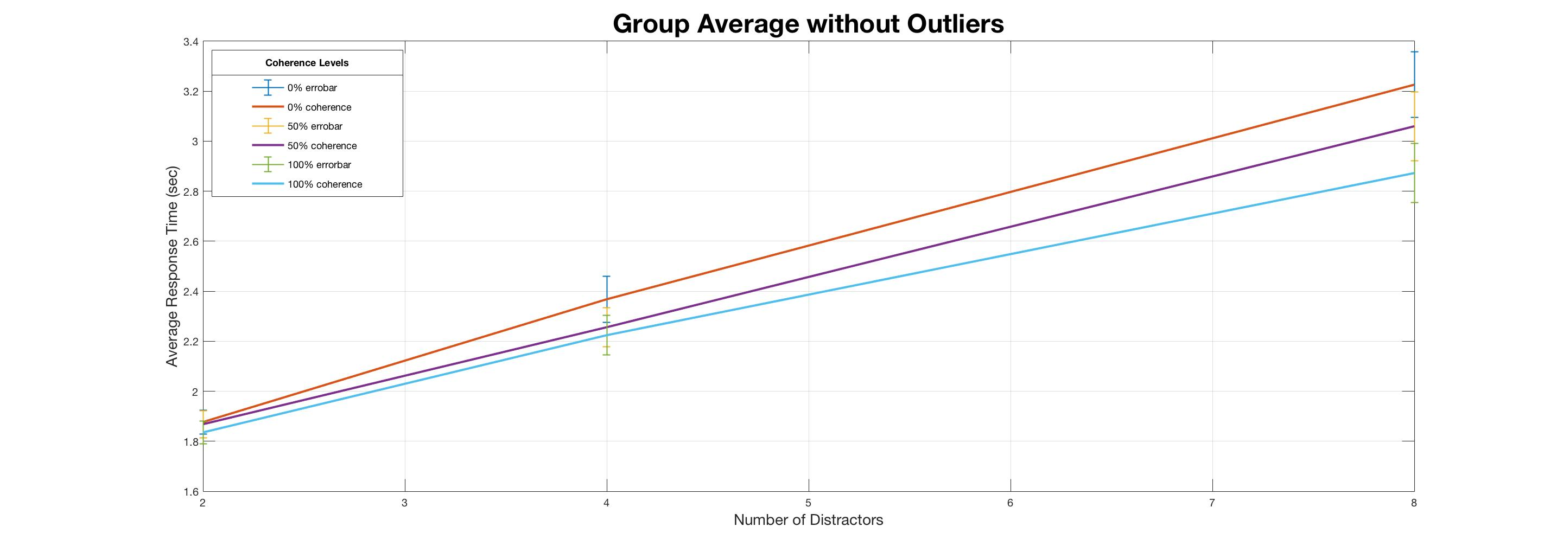
distractor F(1.07, 37.48) = 198.11, p<0.001
coherence F(1.67, 58.54) = 44.30, p<0.001
distractor*coherence F(2.98, 104.14) = 14.96, p<0.001

Slide 9
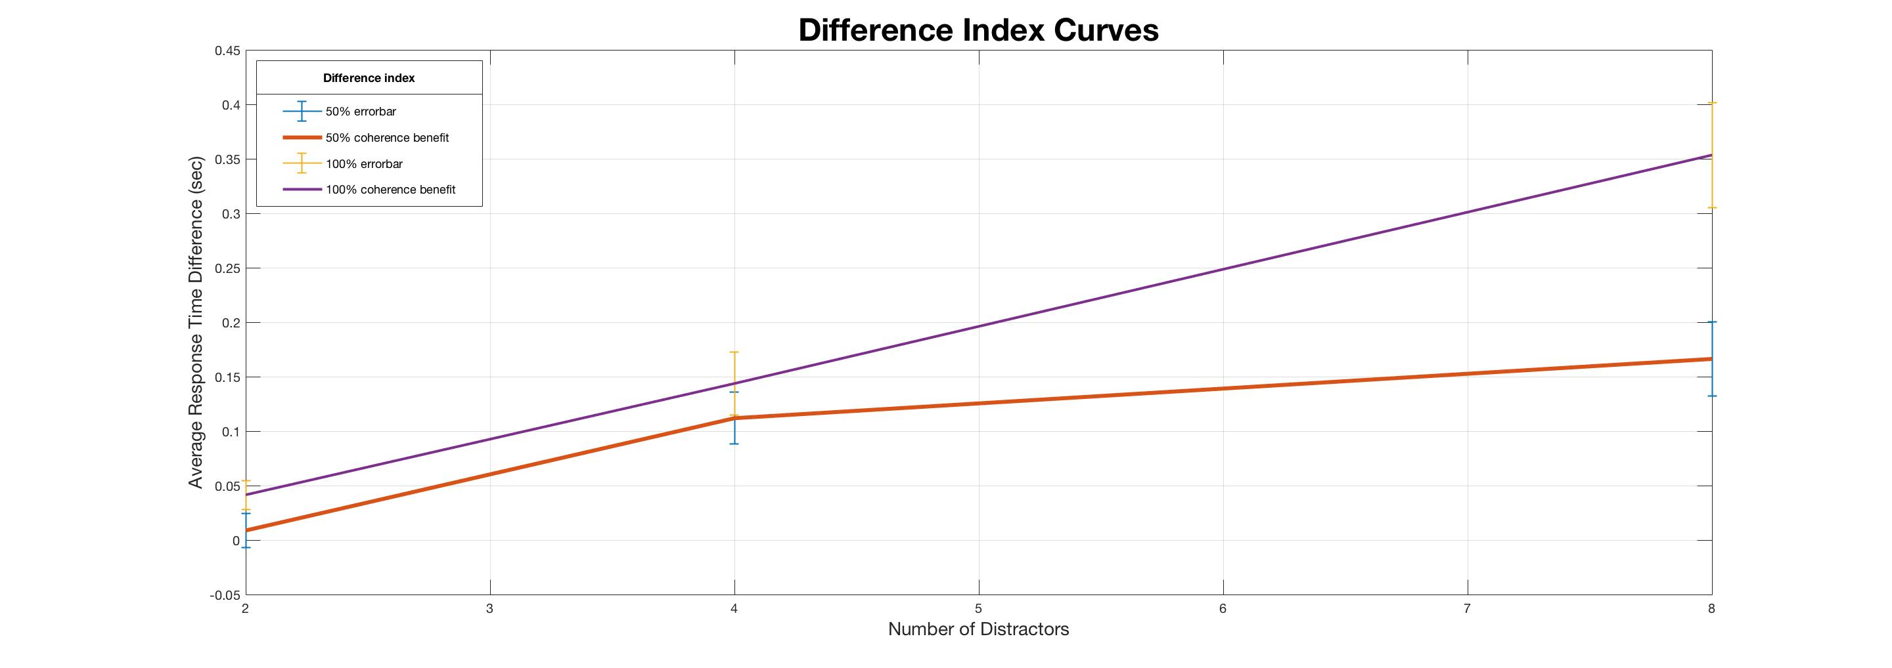
distractor F(1, 35) = 15.67, p<0.001
coherence F(1.76, 61.75) = 22.54, p<0.001
coherence*distractor F(1.49, 52.04) = 8.42, p = 0.002

Slide 10
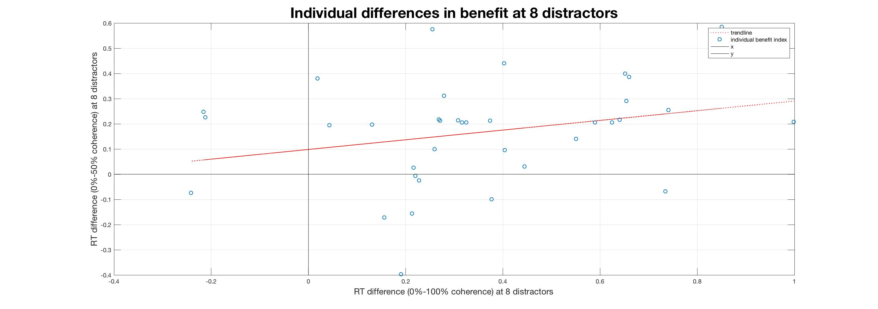
r(34) = 0.27, p = 0.11

Slide 11
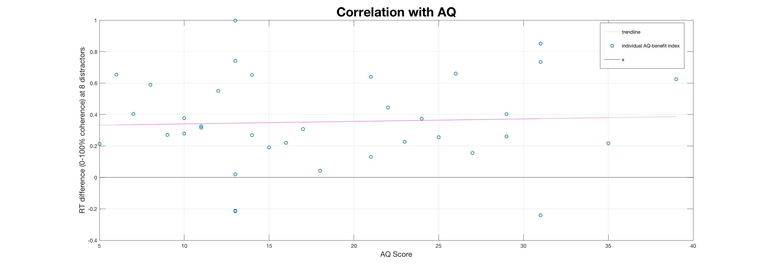
r(34) = 0.05, p = 0.78

Slide 12
**Noticed or Not
Without the 1st Block
&
Full set

Slide 13
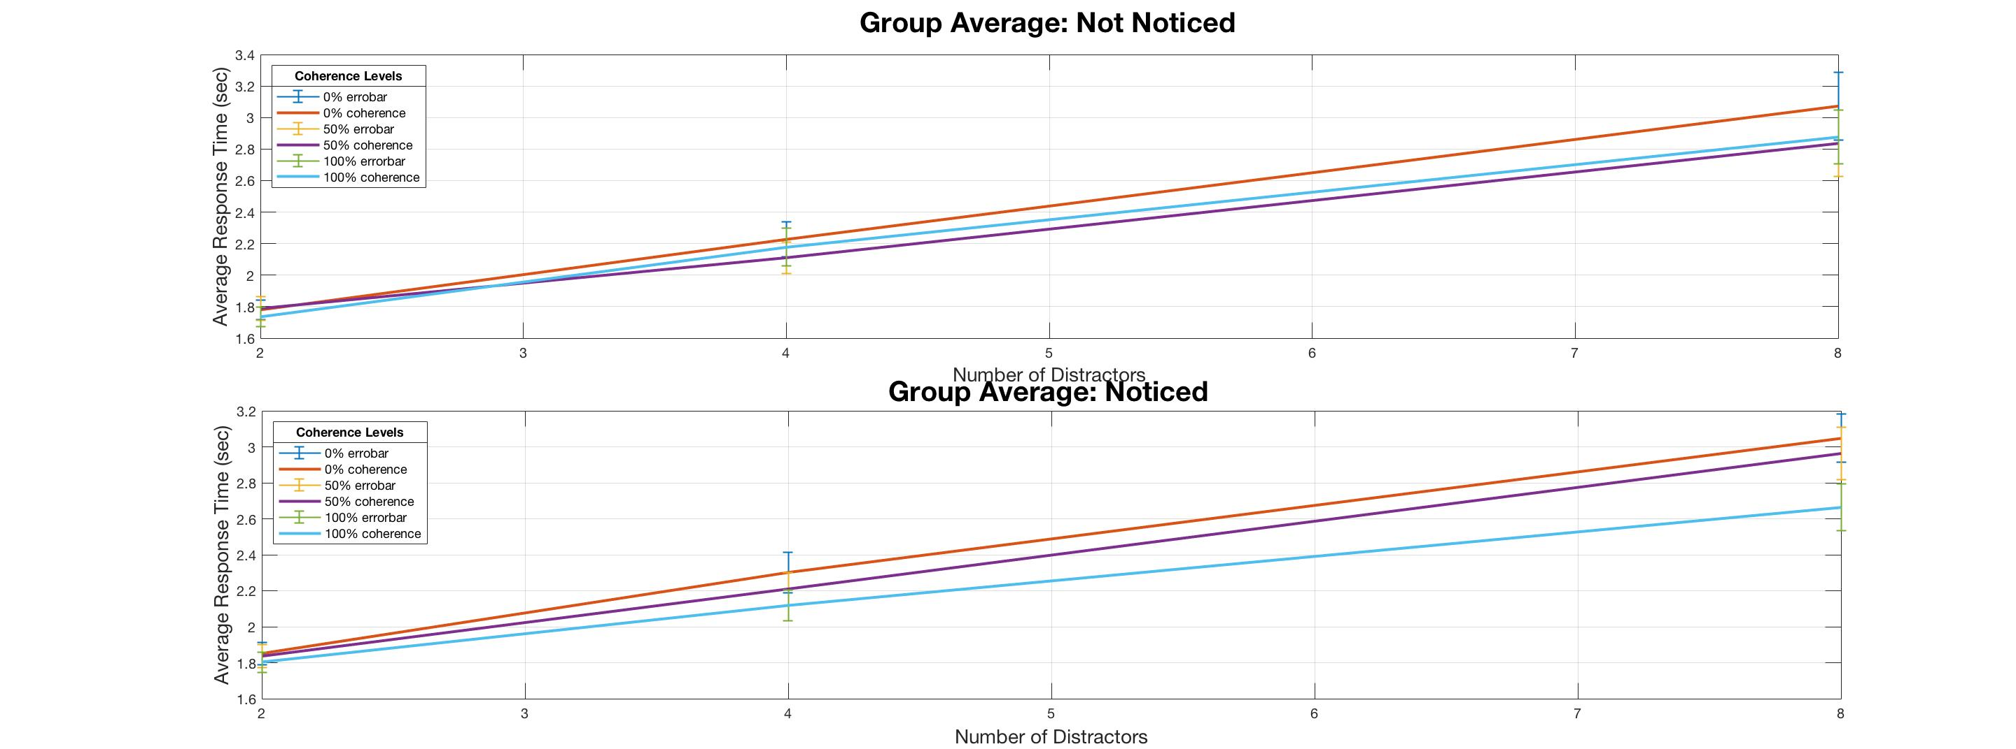
wo
Not-noticed: 50% coherence’s RT is shorter than that of 100% coherence for both 4 & 8 distractors
Not.: 10
Noticed.: 26

Slide 14
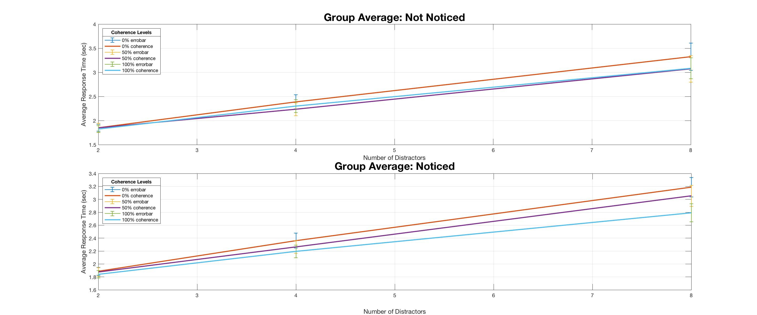

Slide 15
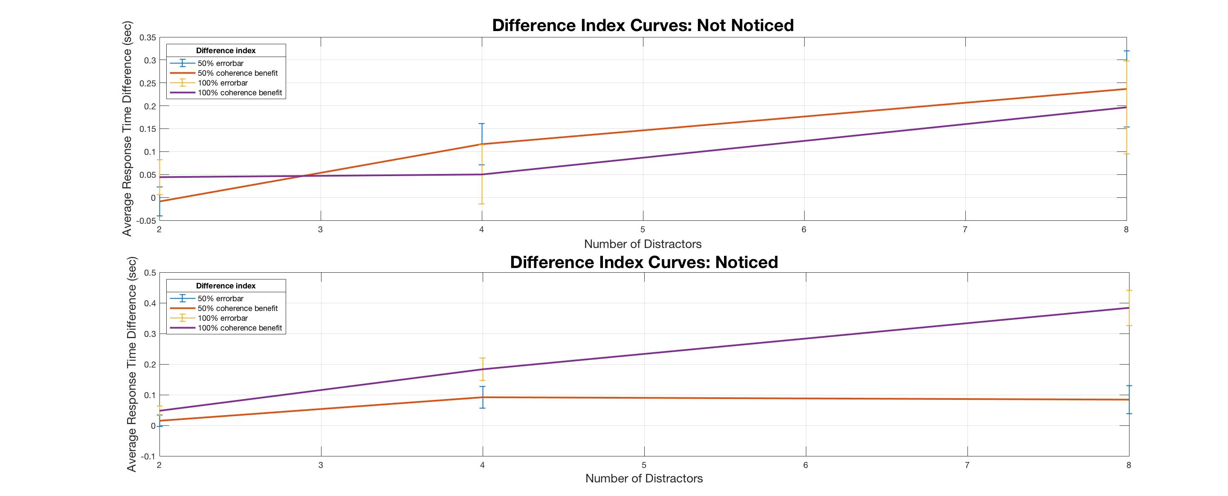
wo
Not-noticed: more benefit from 50% coherence level than from 100% coherence level

Slide 16
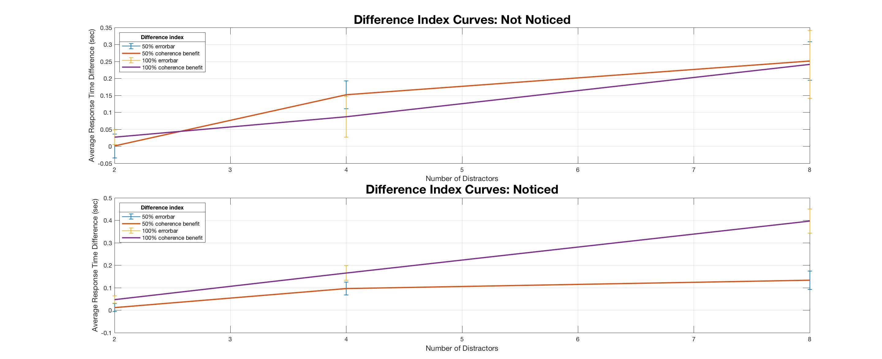

Slide 17
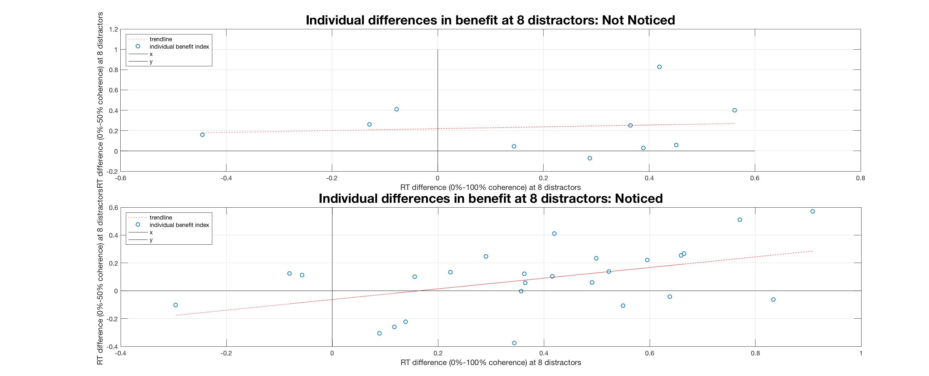
wo
Not-noticed: no correlation, no more points in the 2nd quadrant but most of the points are at the bottom of the 1st quadrant
Noticed: similar to the group (36 participants) plot

Slide 18
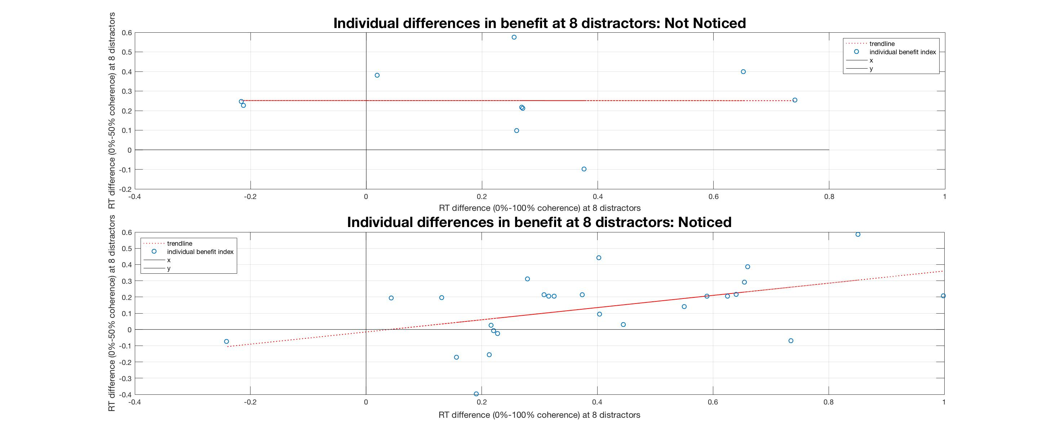

Slide 19
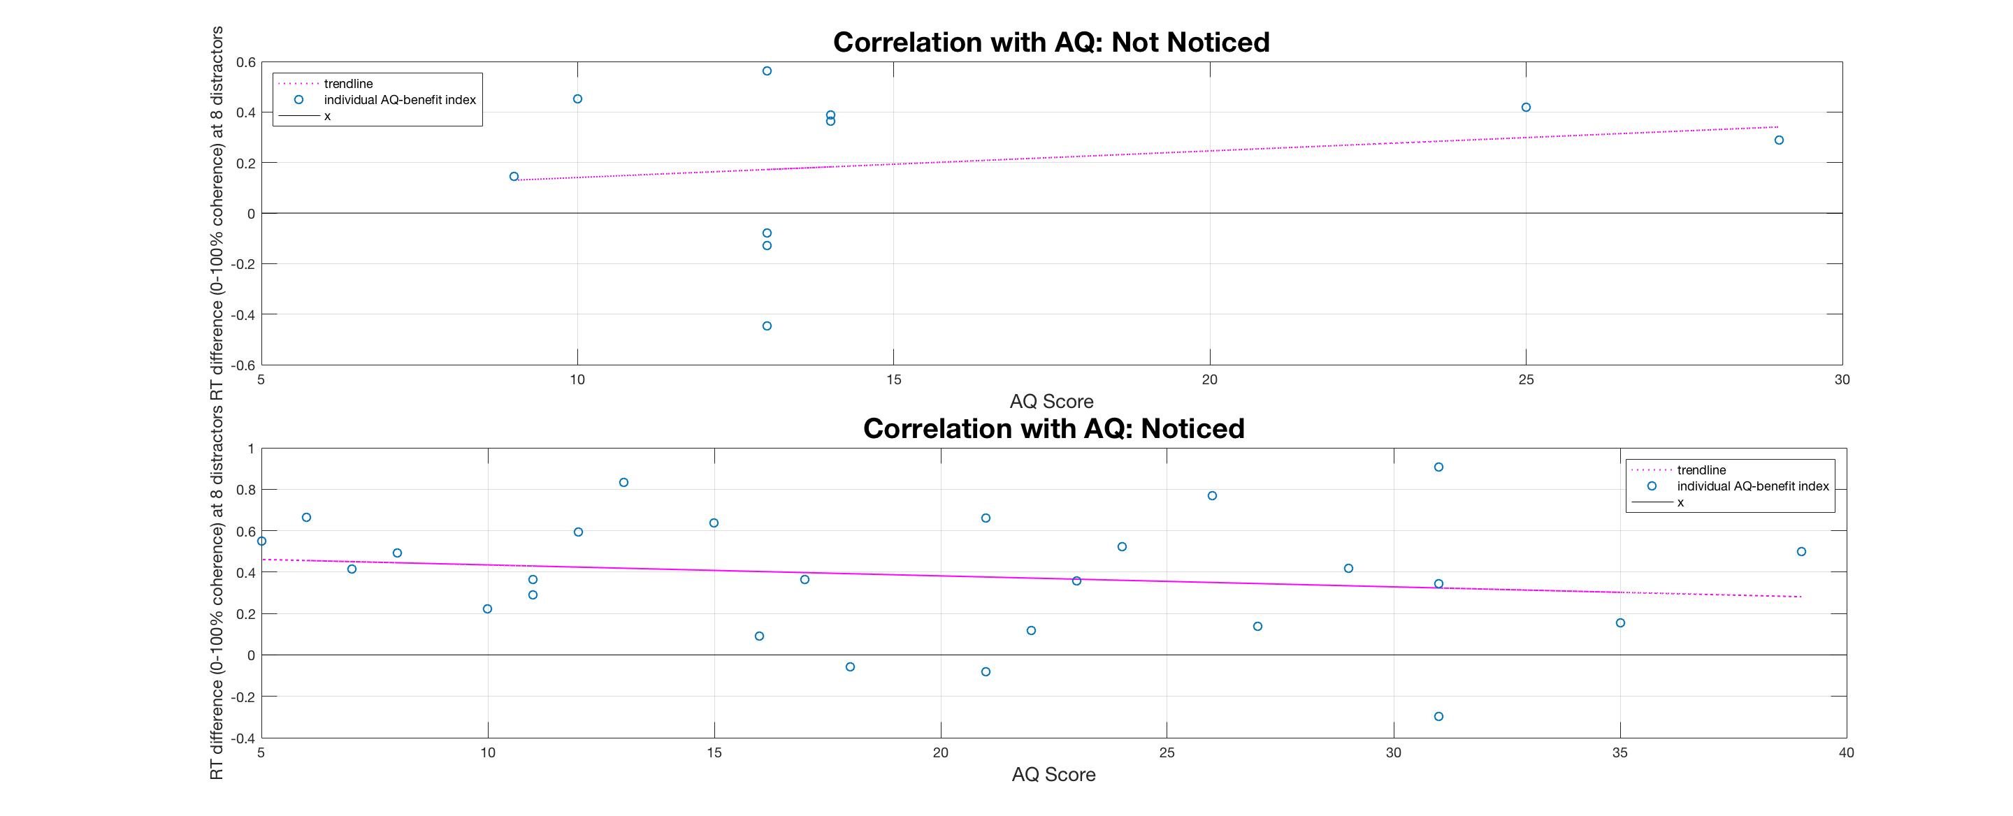
wo

Slide 20
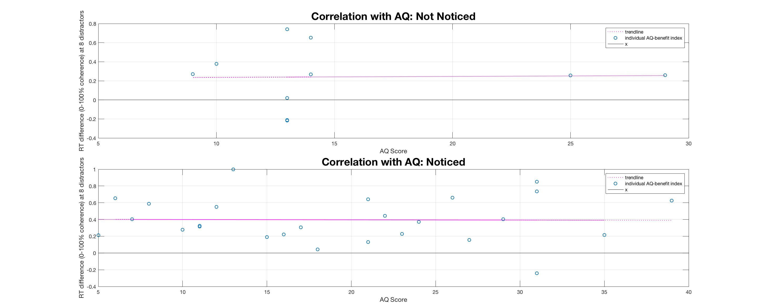

Slide 21
Noticed or Not SPSS stats (2-way repeated measure mixed ANOVA):
50% benefit index: distractor F(1.70, 57.87) = 5.45, p = 0.14
distractor*Notice F(1.70, 57.87) = 1.79, p = 0.05
Notice F(1, 34) = 1.92, p = 0.18
100% benefit index:
distractor F(1.70, 57.93) = 11.25, p = 0.25
distractor*Notice F(1.70, 57.93) = 1.59, p = 0.05
Notice F(1, 34) = 4.61, p = 0.04
RT:
coherence F(2, 68) = 24.00, p<0.001
distractor F(1,07, 36.21) = 205.01, p<0.001
coherence*distractor F(3.00, 101.87) = 6.48, p<0.001
coherence*Notice F(2,68) = 6.86, p = 0.002
distractor*Notice F(1.07, 36.21) = 0.44, p = 0.52
coherence*distractor*Notice F(3.00, 101.87) = 3.12, p = 0.03
Notice F(1, 34) = 0.02, p = 0.90

Slide 22
Used or Not
Without the 1st Block
&
Full set

Slide 23
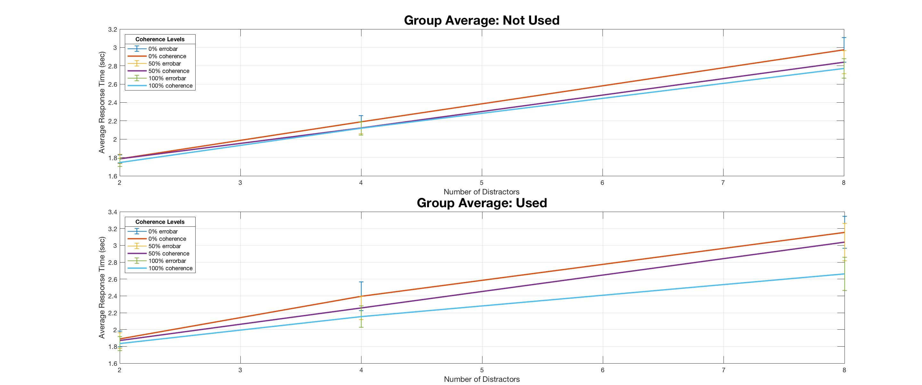
wo
Used: larger RT difference between 50% and 100% coherence level.
(see the sub-group graphs marked with ‘*’)
Not.: 20
Used.: 16

Slide 24
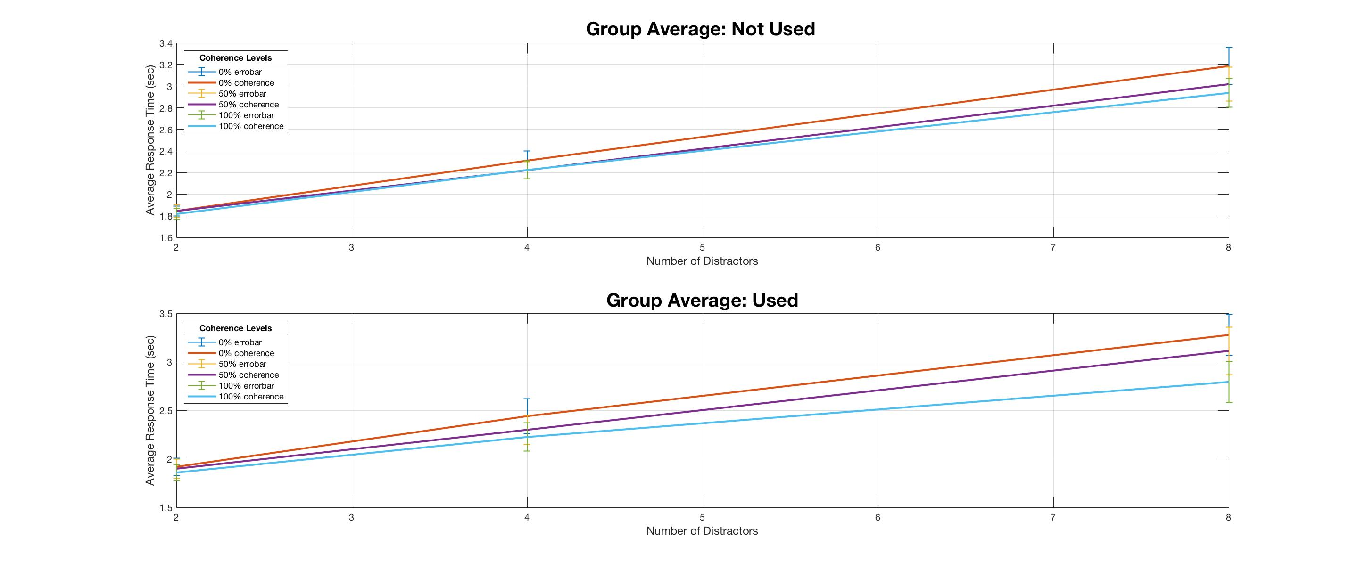

Slide 25
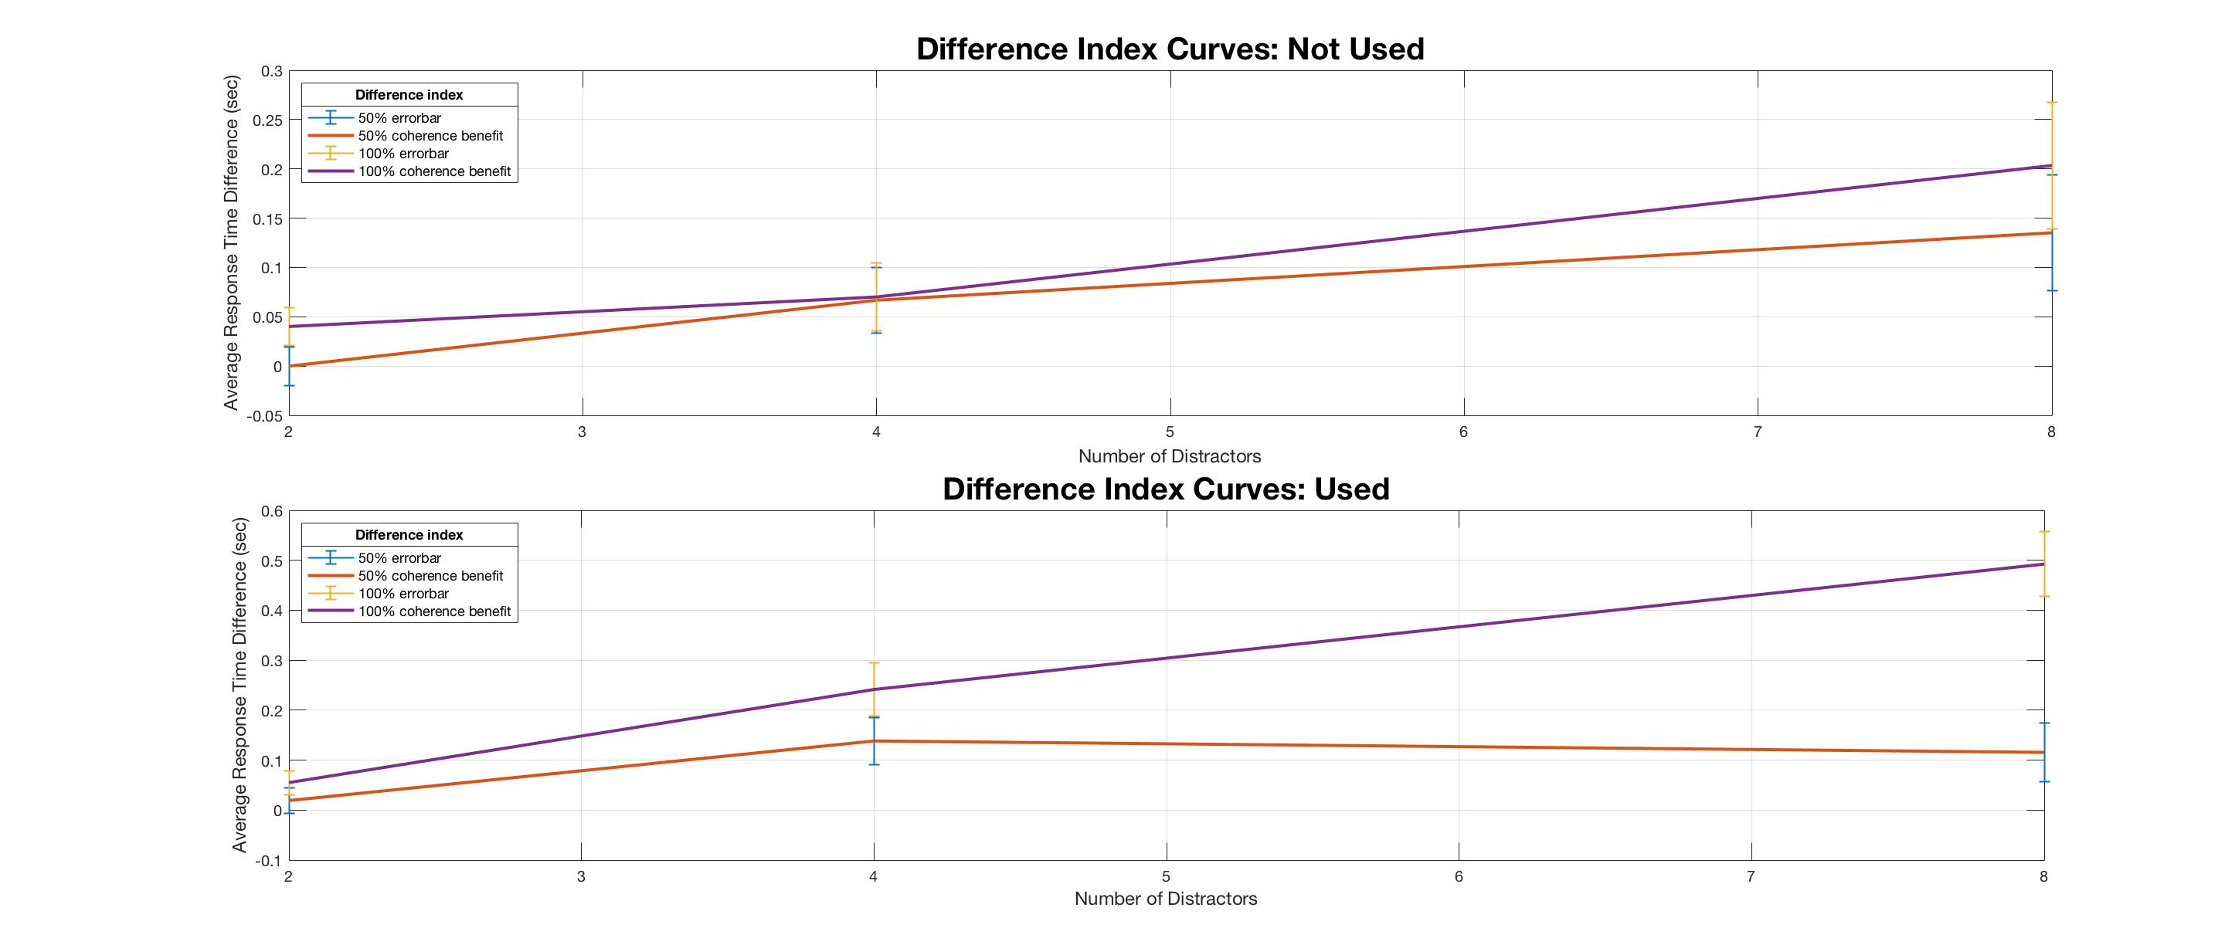
wo
The cue is used at the 8-distractor level when it is available

Slide 26
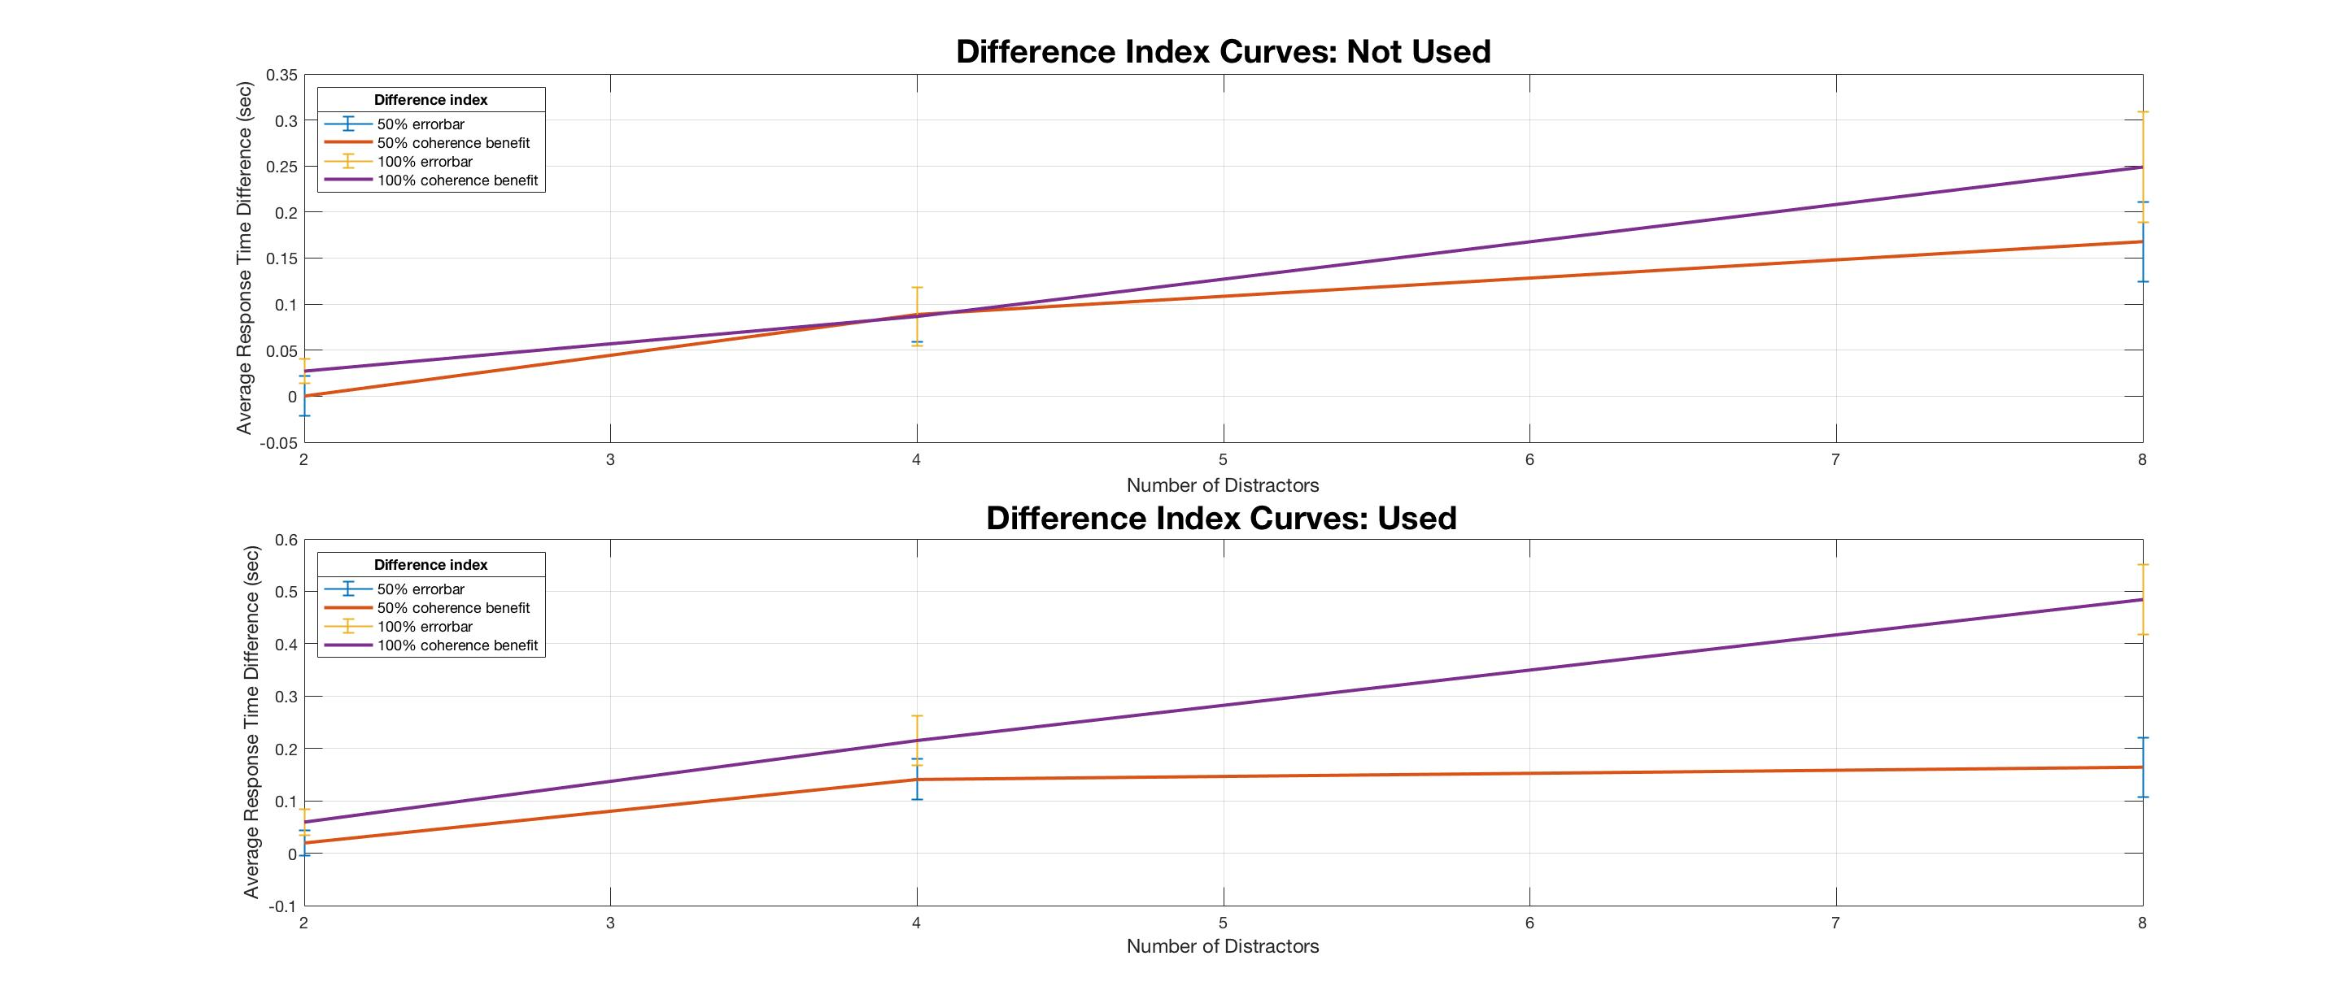

Slide 27
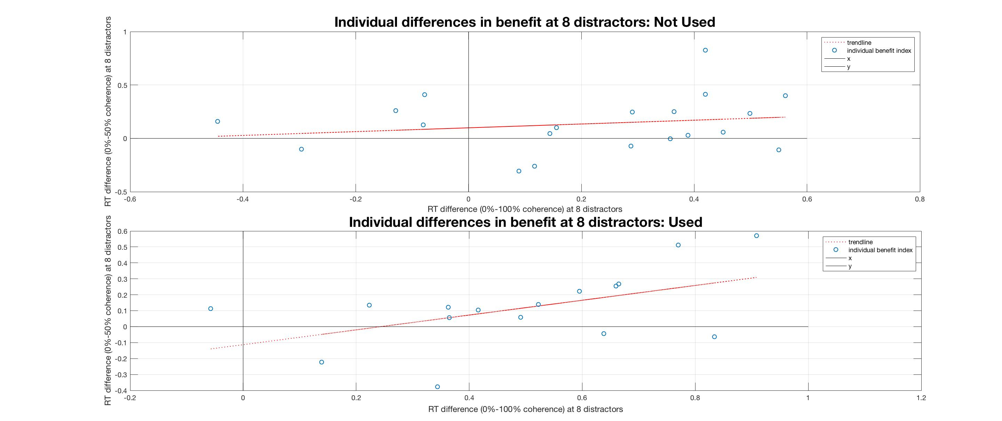
wo

Slide 28
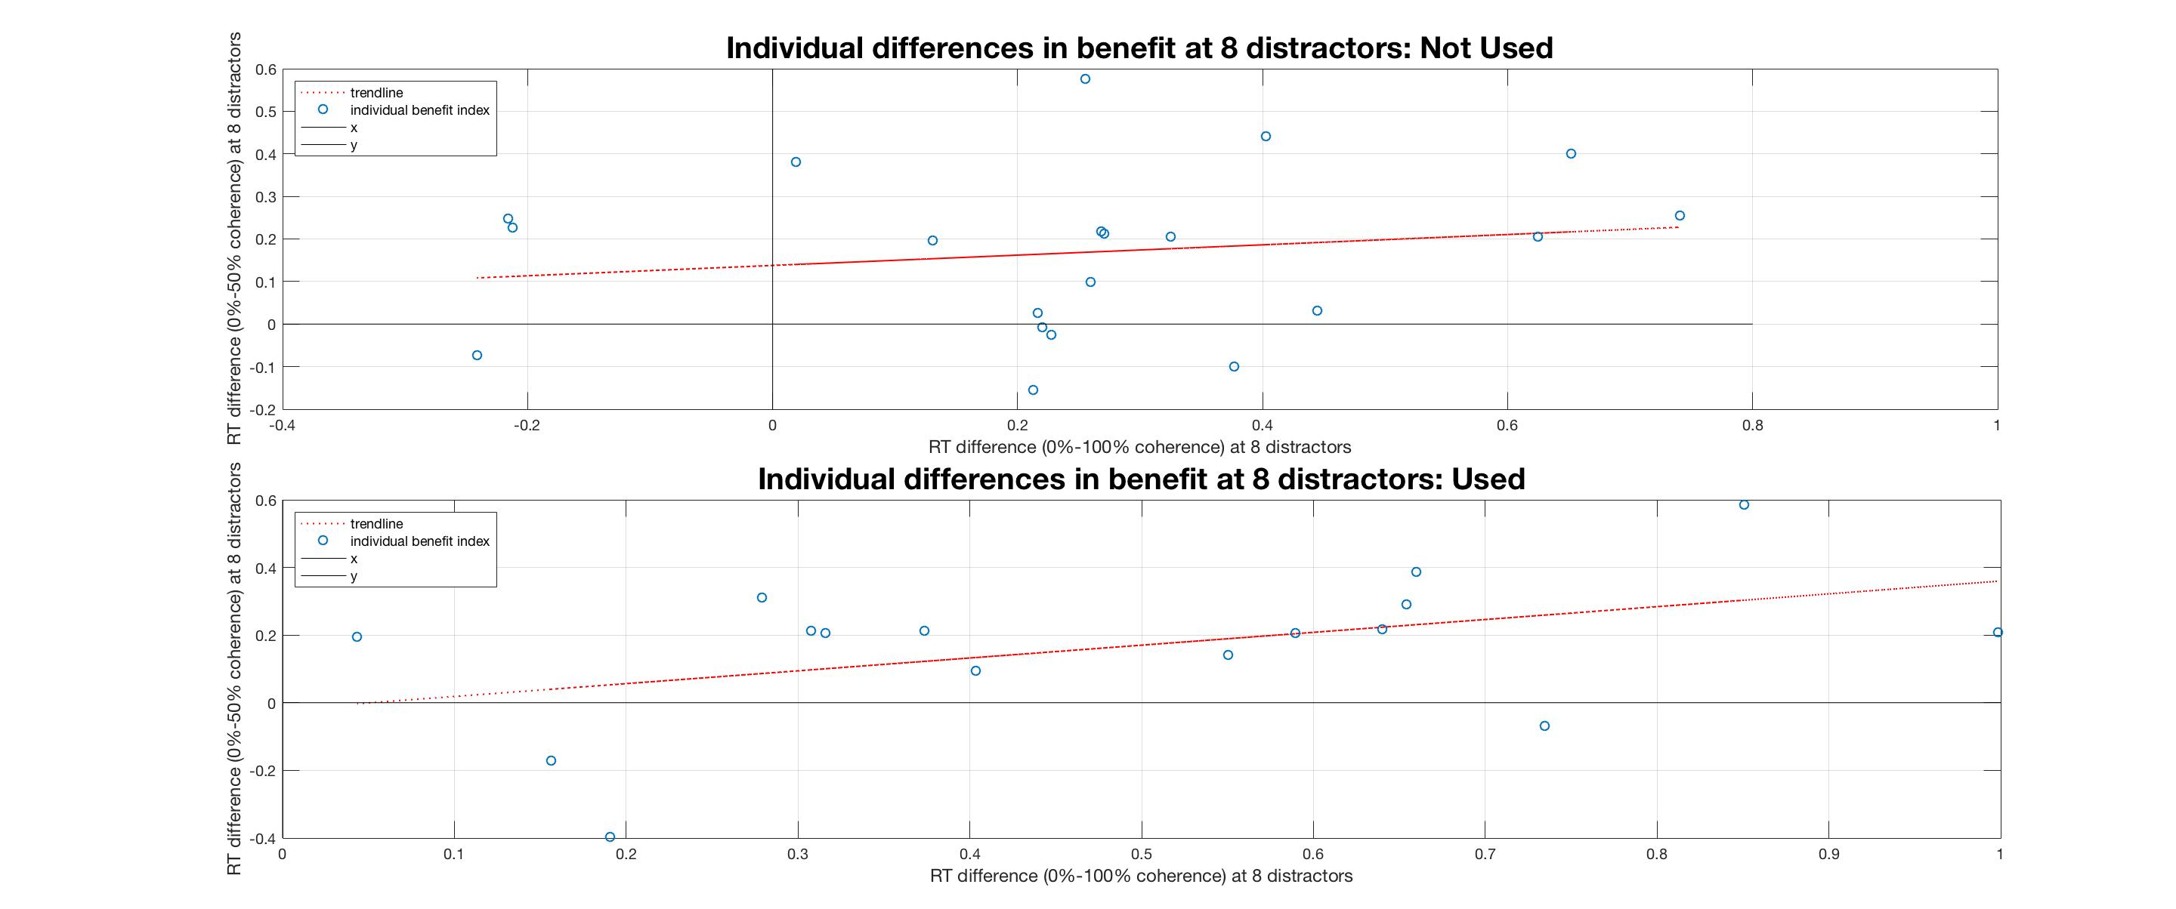

Slide 29
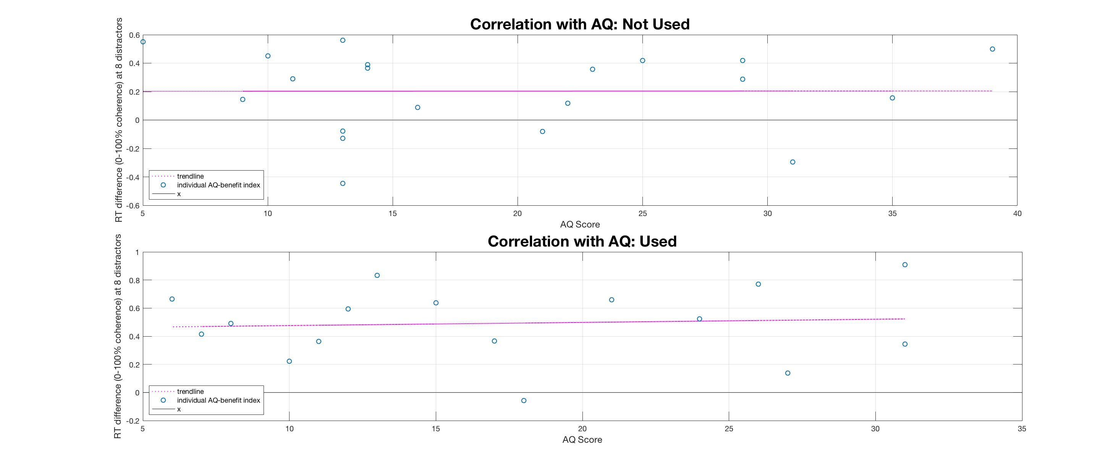
wo

Slide 30
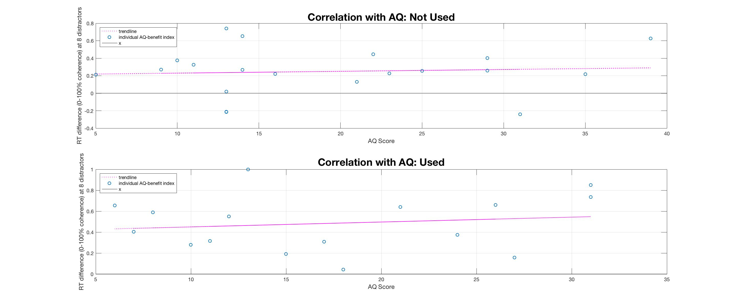

Slide 31
*
- Noticed and Used
- Noticed but not used
- Not noticed and not used

Slide 32
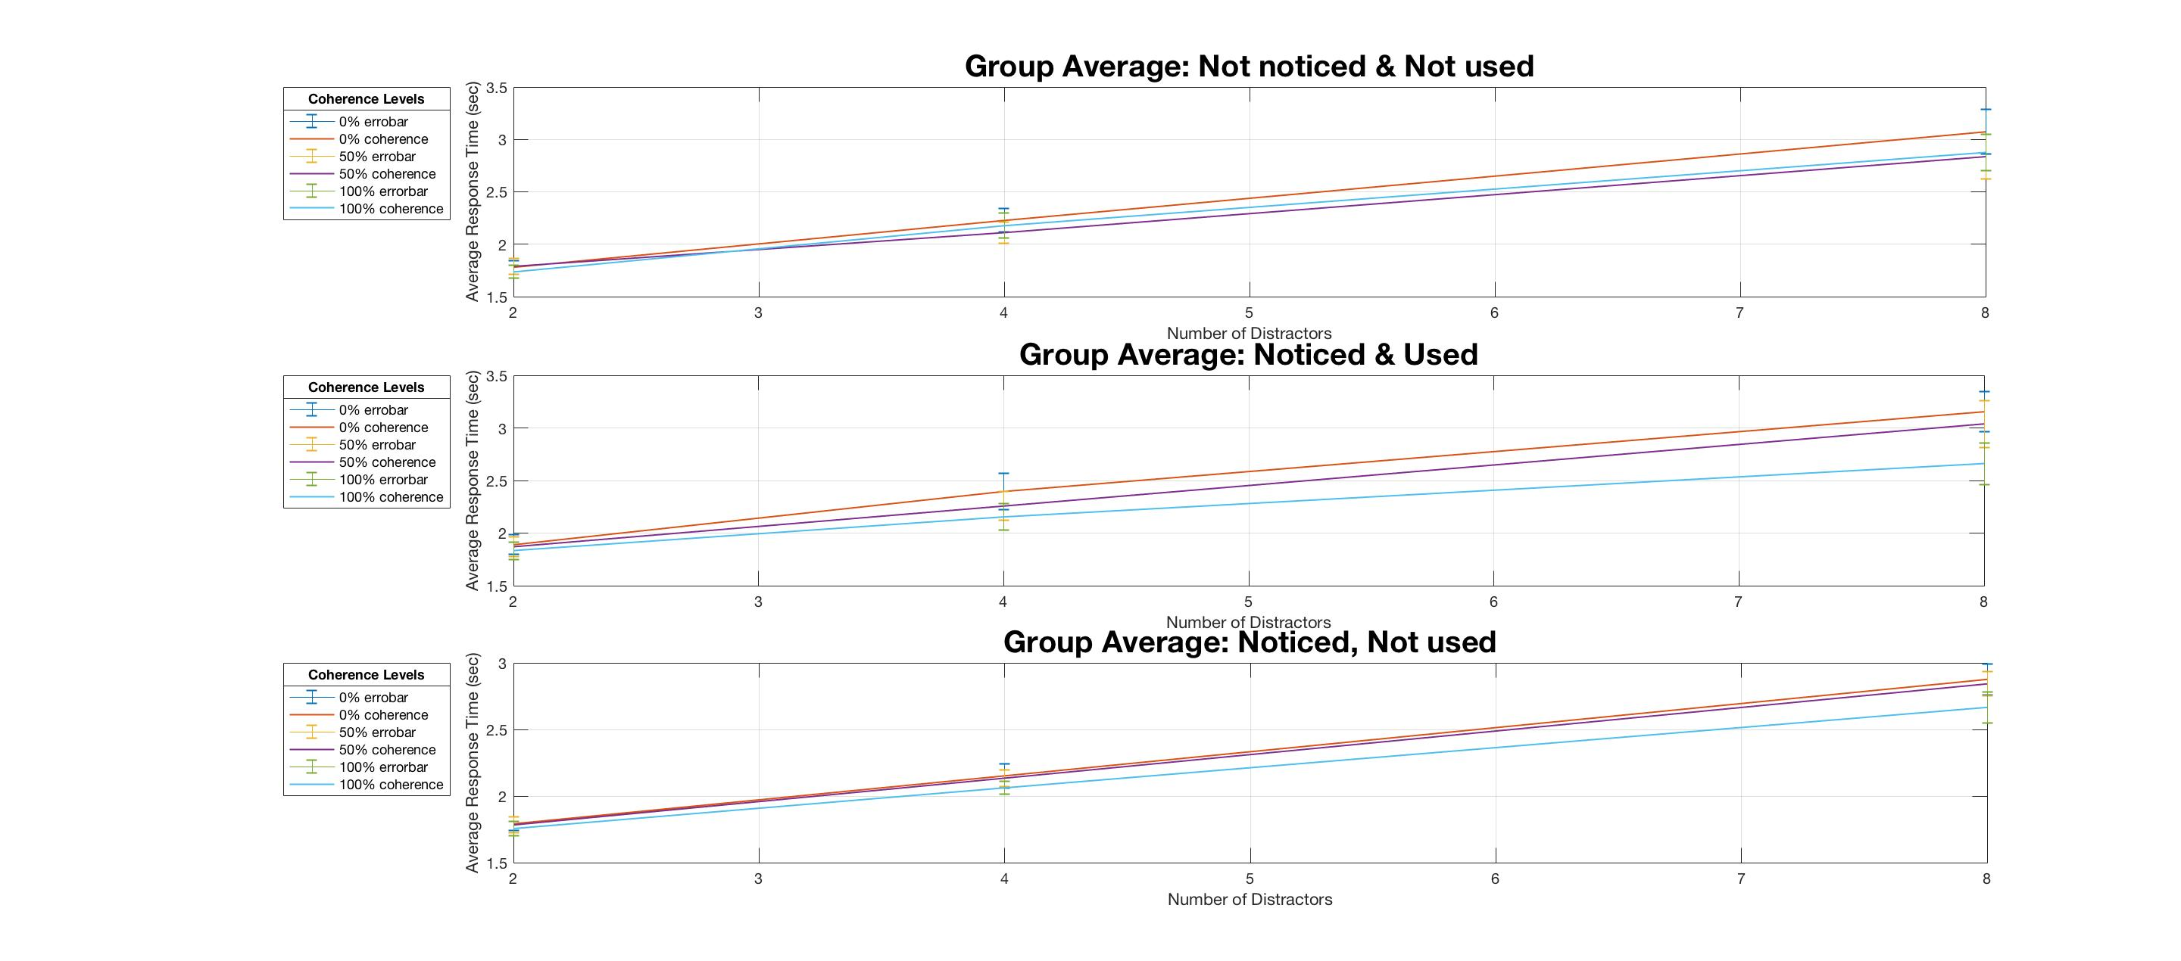
wo

Slide 33
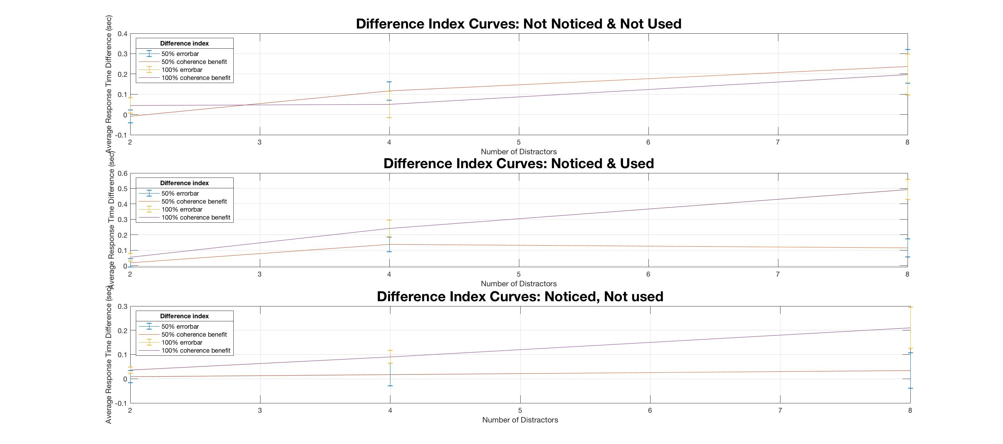
wo

Slide 34
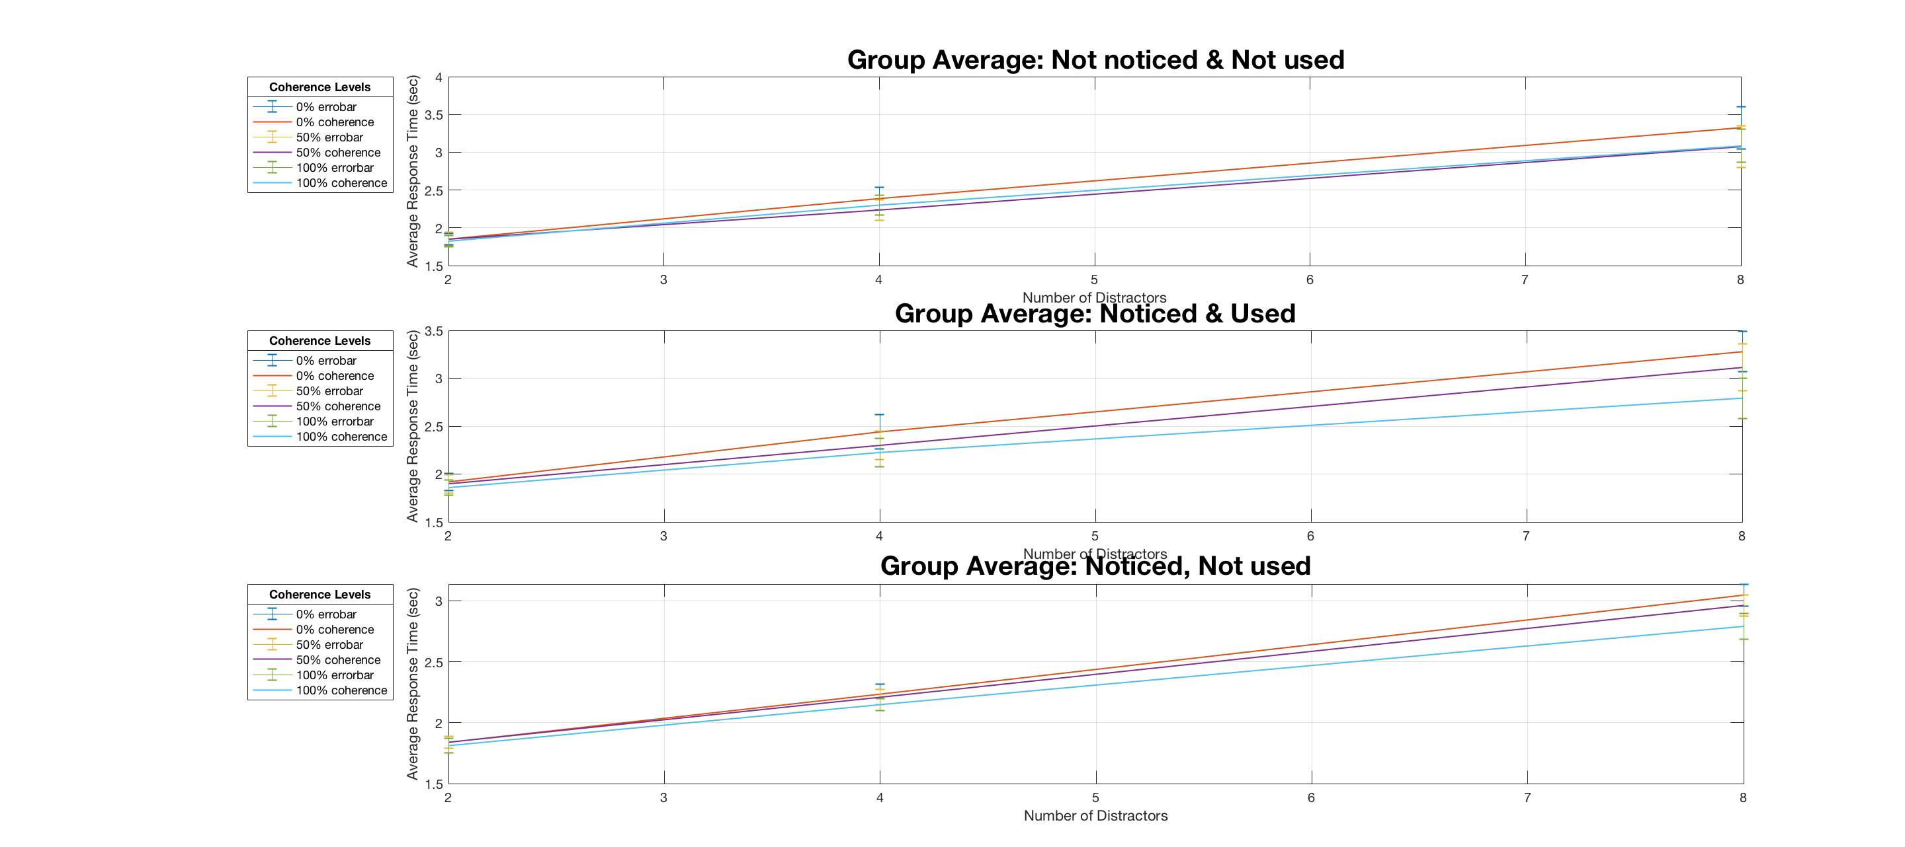

Slide 35
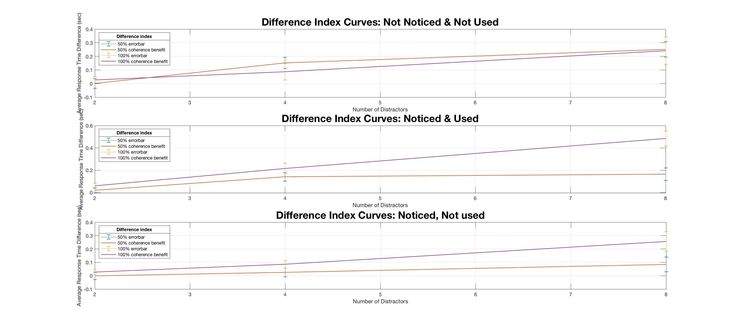

Slide 36
**Noticed or not & Used or not:
50% benefit index (2-way):
distractor F(1.72, 56.63) = 3.95, p = 0.03
distractor*Notice F(3.34, 56.63) = 1.17, p = 0.33
Notice F(2, 33) = 2.73, p = 0.08
100% benefit index:
distractor F(1.74, 57.54) = 15.01, p<0.001
distractor*Notice F(3.49, 57.54) = 2.22, p = 0.09
Notice F(2, 33) = 7.70, p = 0.002
RT (3-way):
coherence F(2, 66) = 34.91, p<0.001
coherence*Notice F(4, 66) = 5.80, p<0.001
distractor F(1.06, 35.03) = 228.42. p<0.001
distractor*Notice F(2.12, 35.03) = 0.32, p = 0.74
coherence*distractor F(3.54, 116.91) = 8.13, p<0.001
coherence*distractor*Noticed F(7.09, 116.91) = 2.45, p = 0.02
Notice F(2, 33) = 0.26, p = 0.77
Benefit index (50% + 100% (3-way) ):
coherence F(1, 33) = 18.10, p<0.001
coherence*Notice F(2, 33) = 8.68, p = 0.001
distractor F(1.77, 58.36) = 11.64, p<0.001
distractor*Notice F(3.54, 58.36) = 0.94, p = 0.44
coherence*distractor F(1.61, 53.25) = 5.07, p = 0.02
coherence*distractor*Notice F(3.23, 53.25) = 3.76, p = 0.01
Notice F(2, 33) = 4.72, p = 0.02.

Slide 37
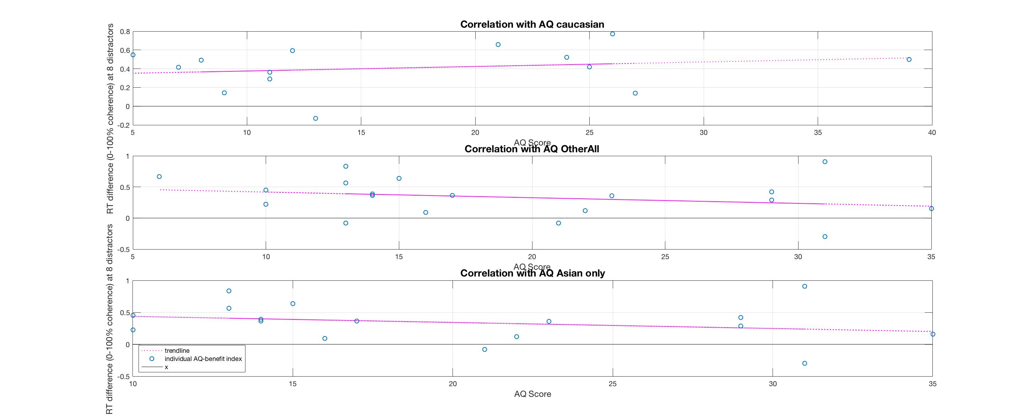
AQ Correlations Races:
r(12) = 0.2, p = 0.49
r(17) = -0.25, p = 0.31
r(15) = -0.25, p = 0.33

Slide 38
Eye Data
Without the 1st block
&
Full set

Slide 39
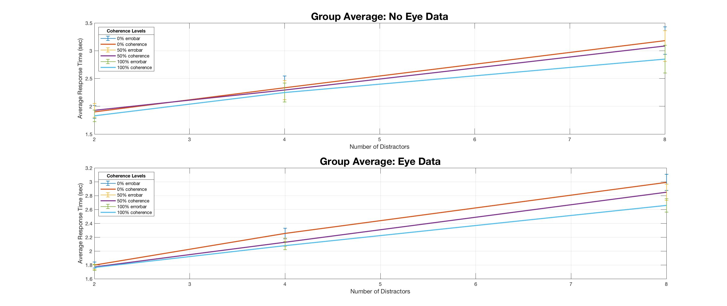
wo
Not.: 12
Available.: 24

Slide 40
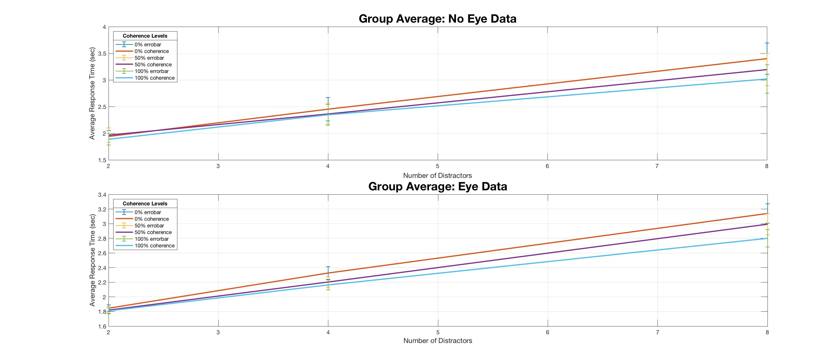

Slide 41
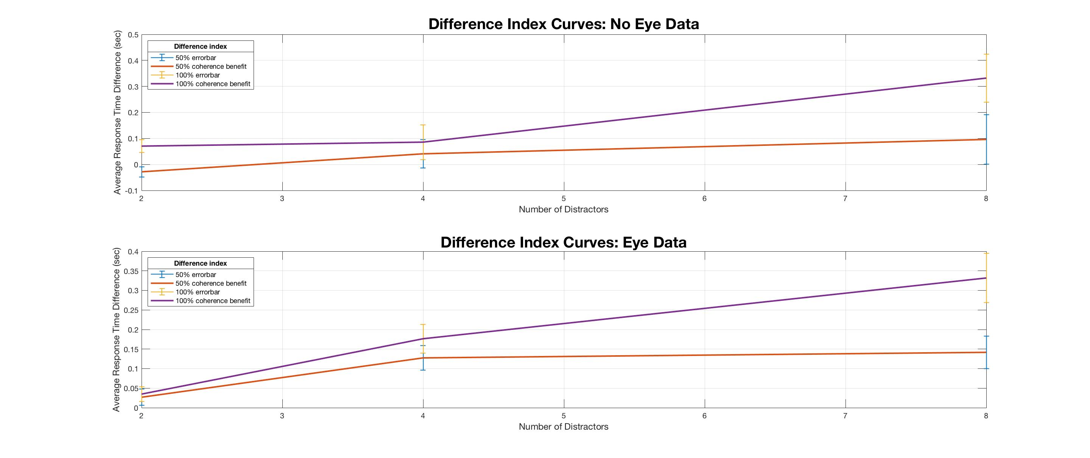
wo

Slide 42
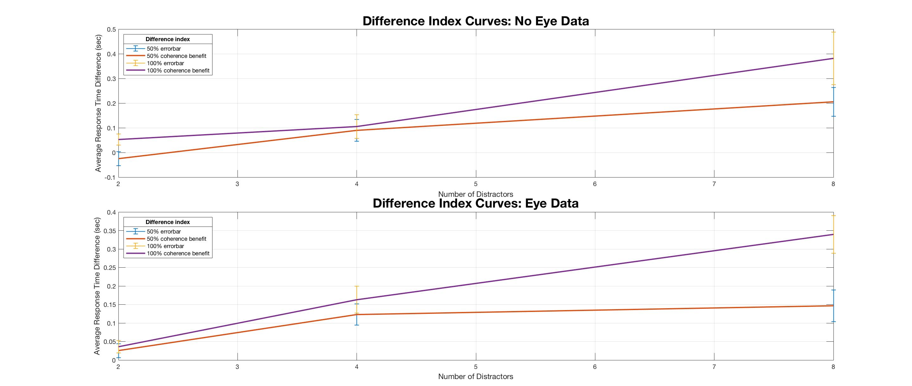

Slide 43
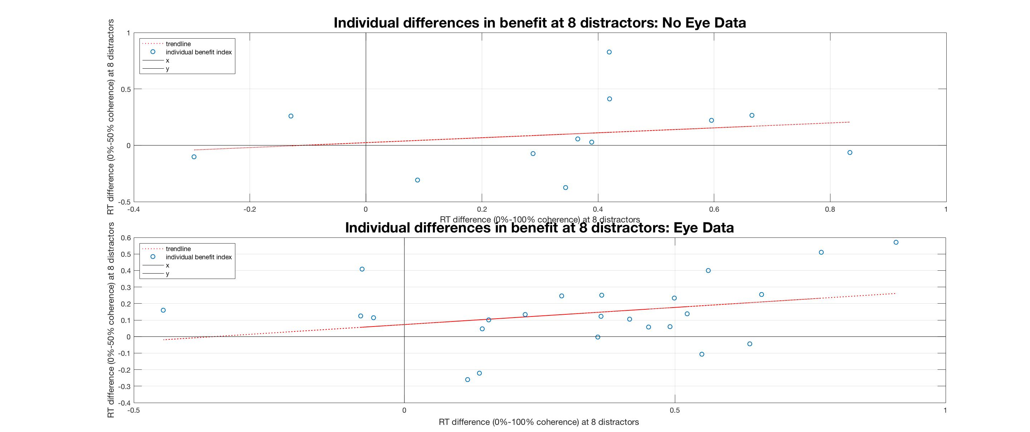
wo

Slide 44
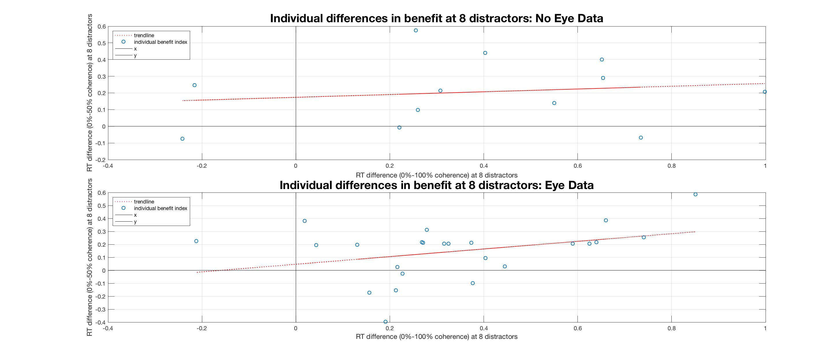

Slide 45
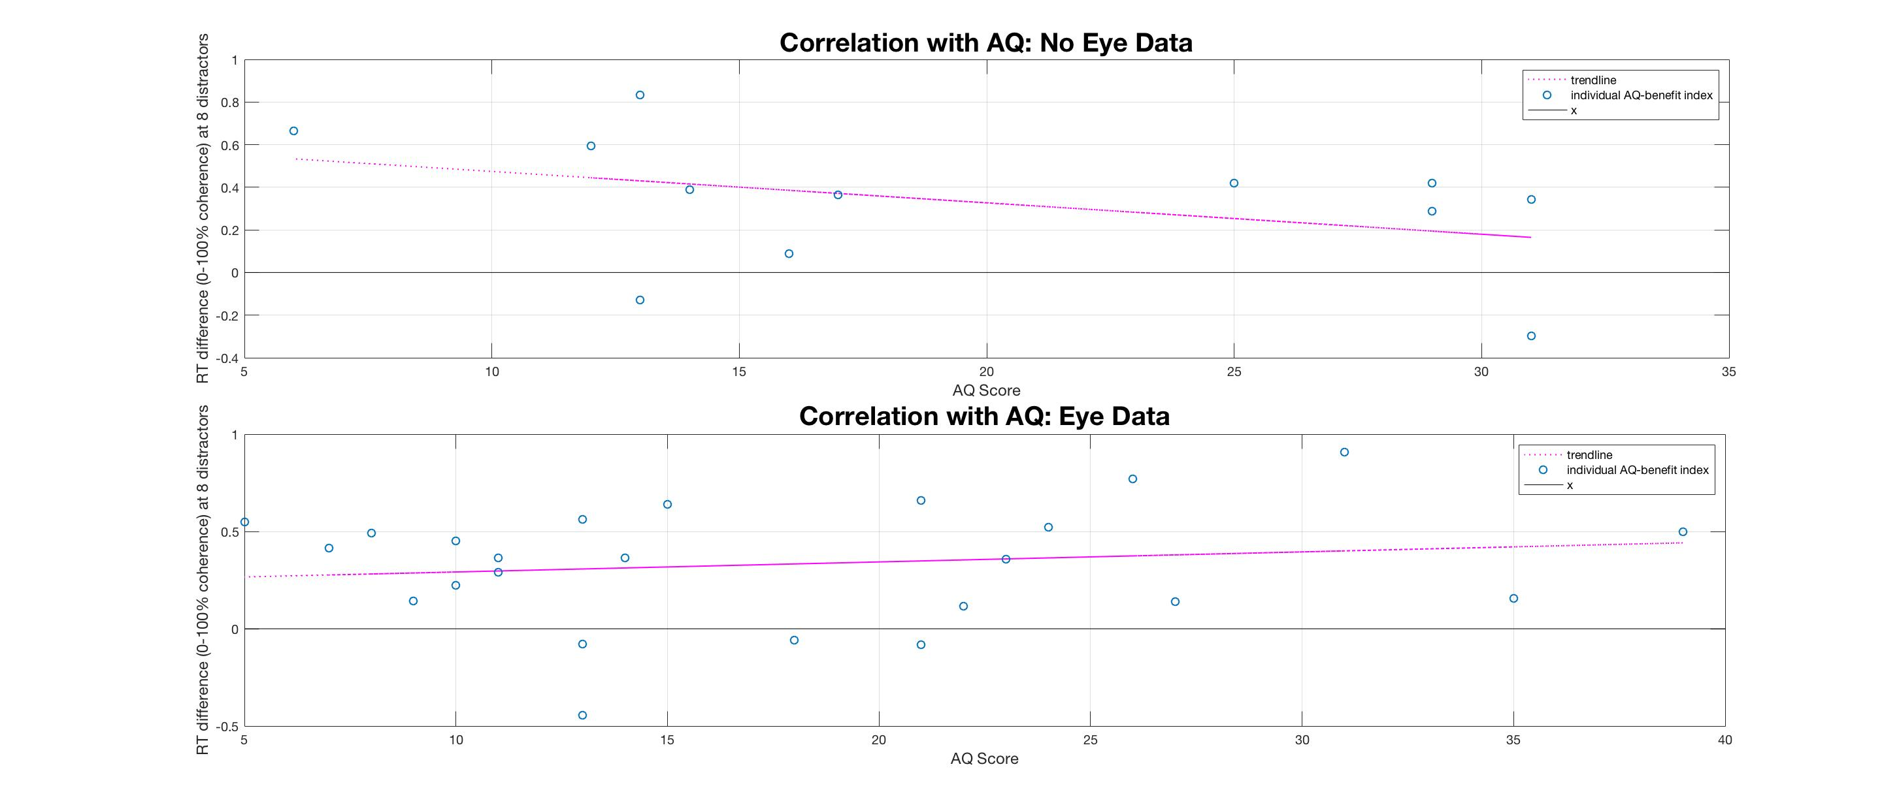
wo

Slide 46
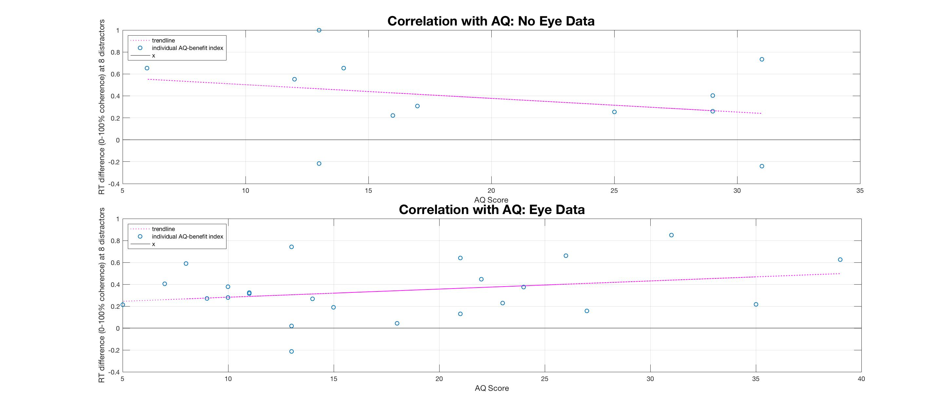

Slide 47
Eye Data Availability:
50% benefit index: distractor F(1.68, 57.26) = 3.44, p = 0.05
distractor*Eye F(1.68, 57.26) = 0.10, p = 0.87
Eye F(1, 34) = 3.31, p = 0.08
100% benefit index:
distractor F(1.68, 57.22) = 16.00, p<0.001
distractor* Eye F(1.68, 57.22) = 0.82, p = 0.43
Eye F(1, 34) = 0.13, p = 0.72
RT:
coherence F(1.73, 58.97) = 41.28, p<0.001
distractor F(1.07, 36.28) = 177.00, p<0.001
coherence*distractor F(3.44, 117.00) = 16.52, p<0.001
coherence* Eye F(1.73, 58.97) = 0.46, p = 0.61
distractor* Eye F(1.07, 36.28) = 0.31, p = 0.60
coherence*distractor* Eye F(3.44, 117.00) = 1.42, p = 0.23
Eye F(1, 34) = 0.14, p = 0.71

Slide 48
Feature Finding
Without the 1st block
&
Full set

Slide 49
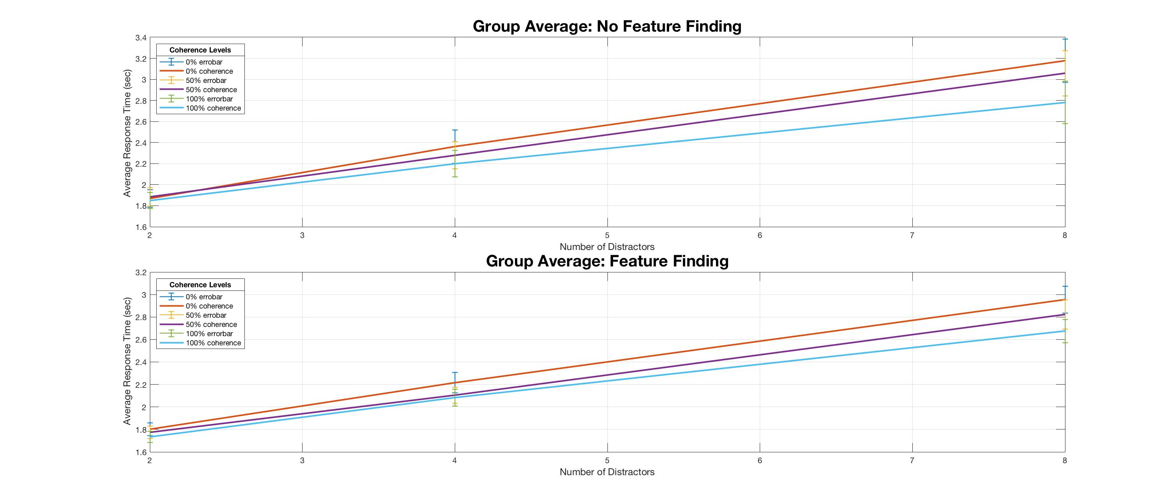
wo
*The lines are closer to each other for the full dataset graphs.
No.: 16
Feature.: 20

Slide 50
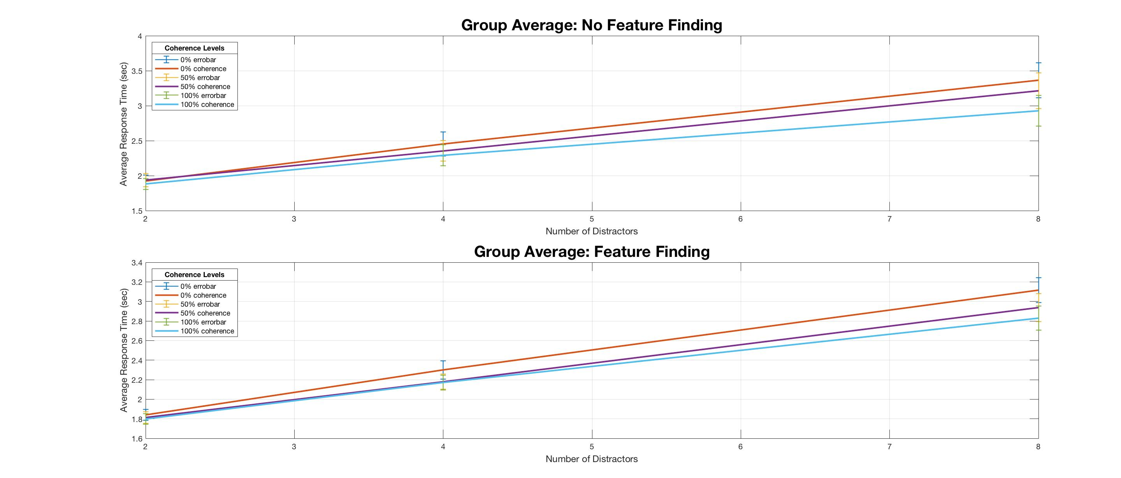

Slide 51
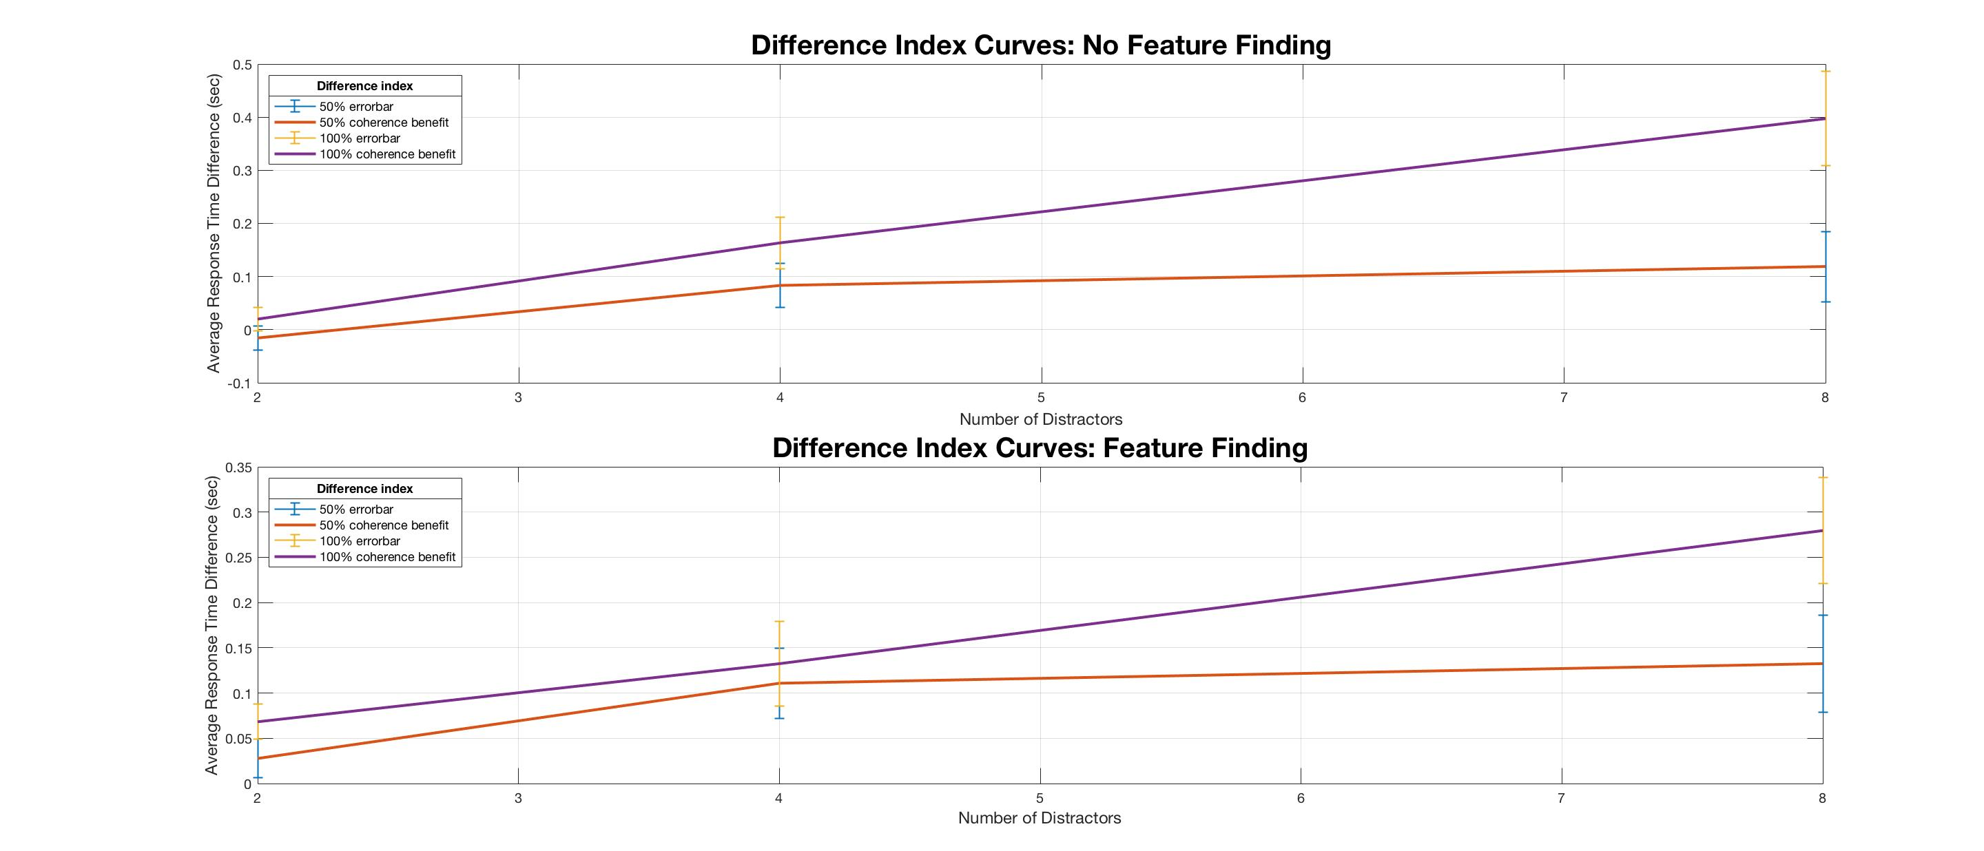
wo

Slide 52
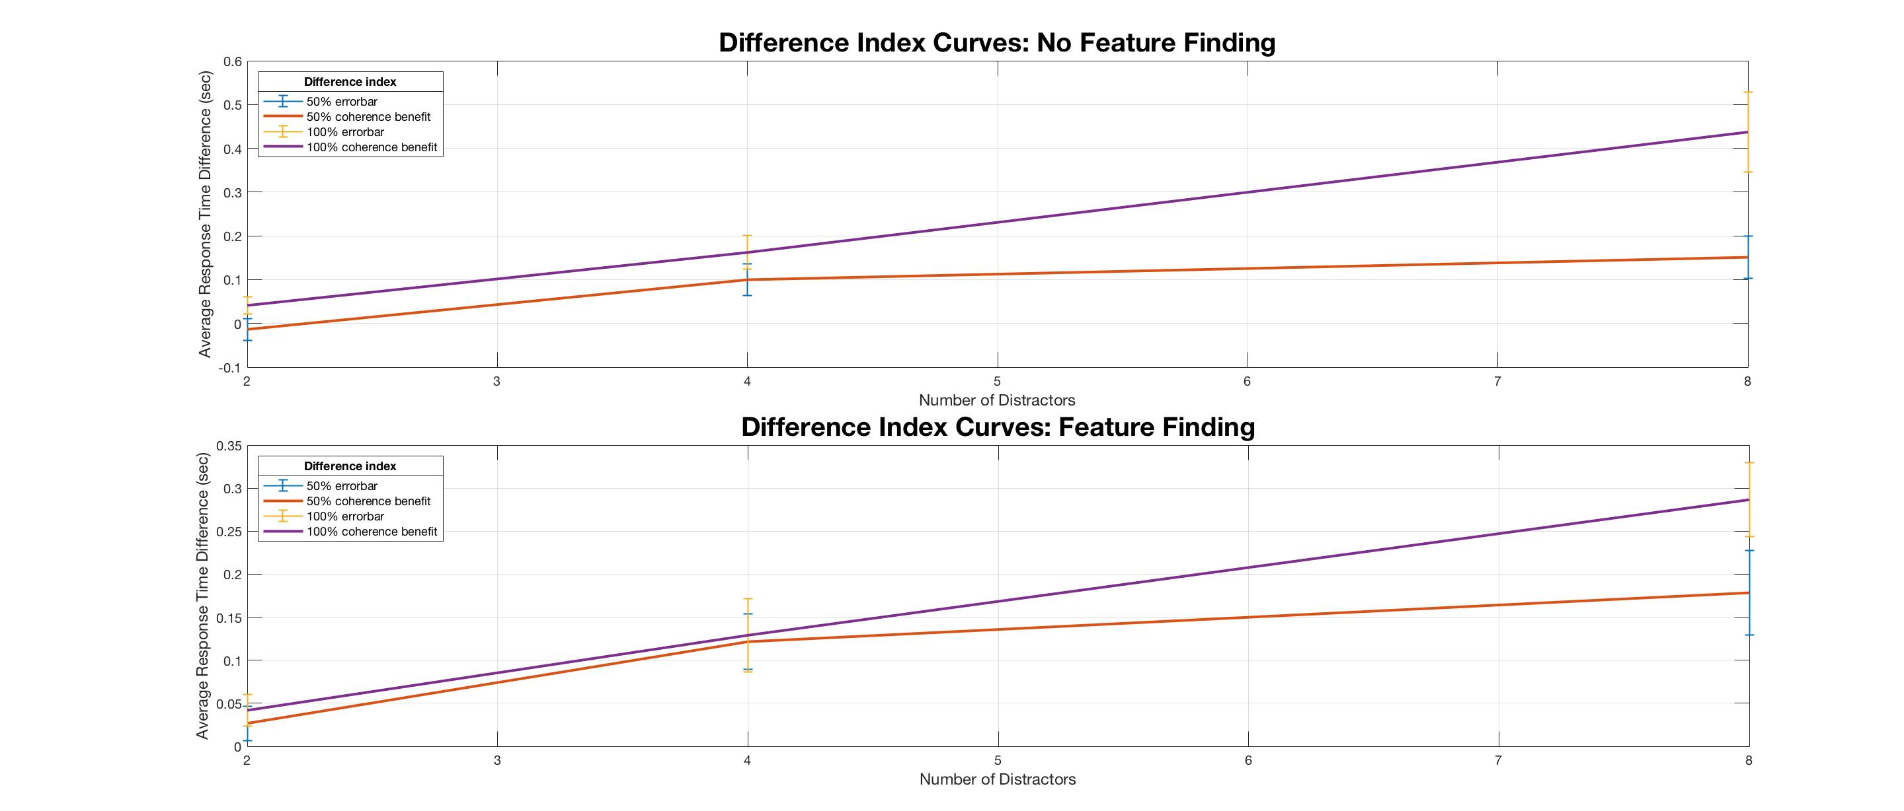

Slide 53
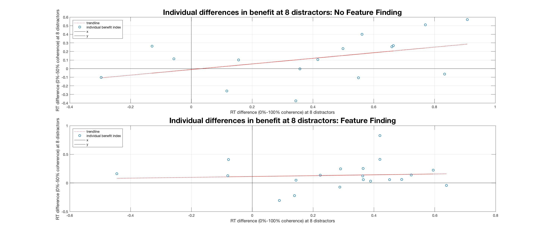
wo

Slide 54
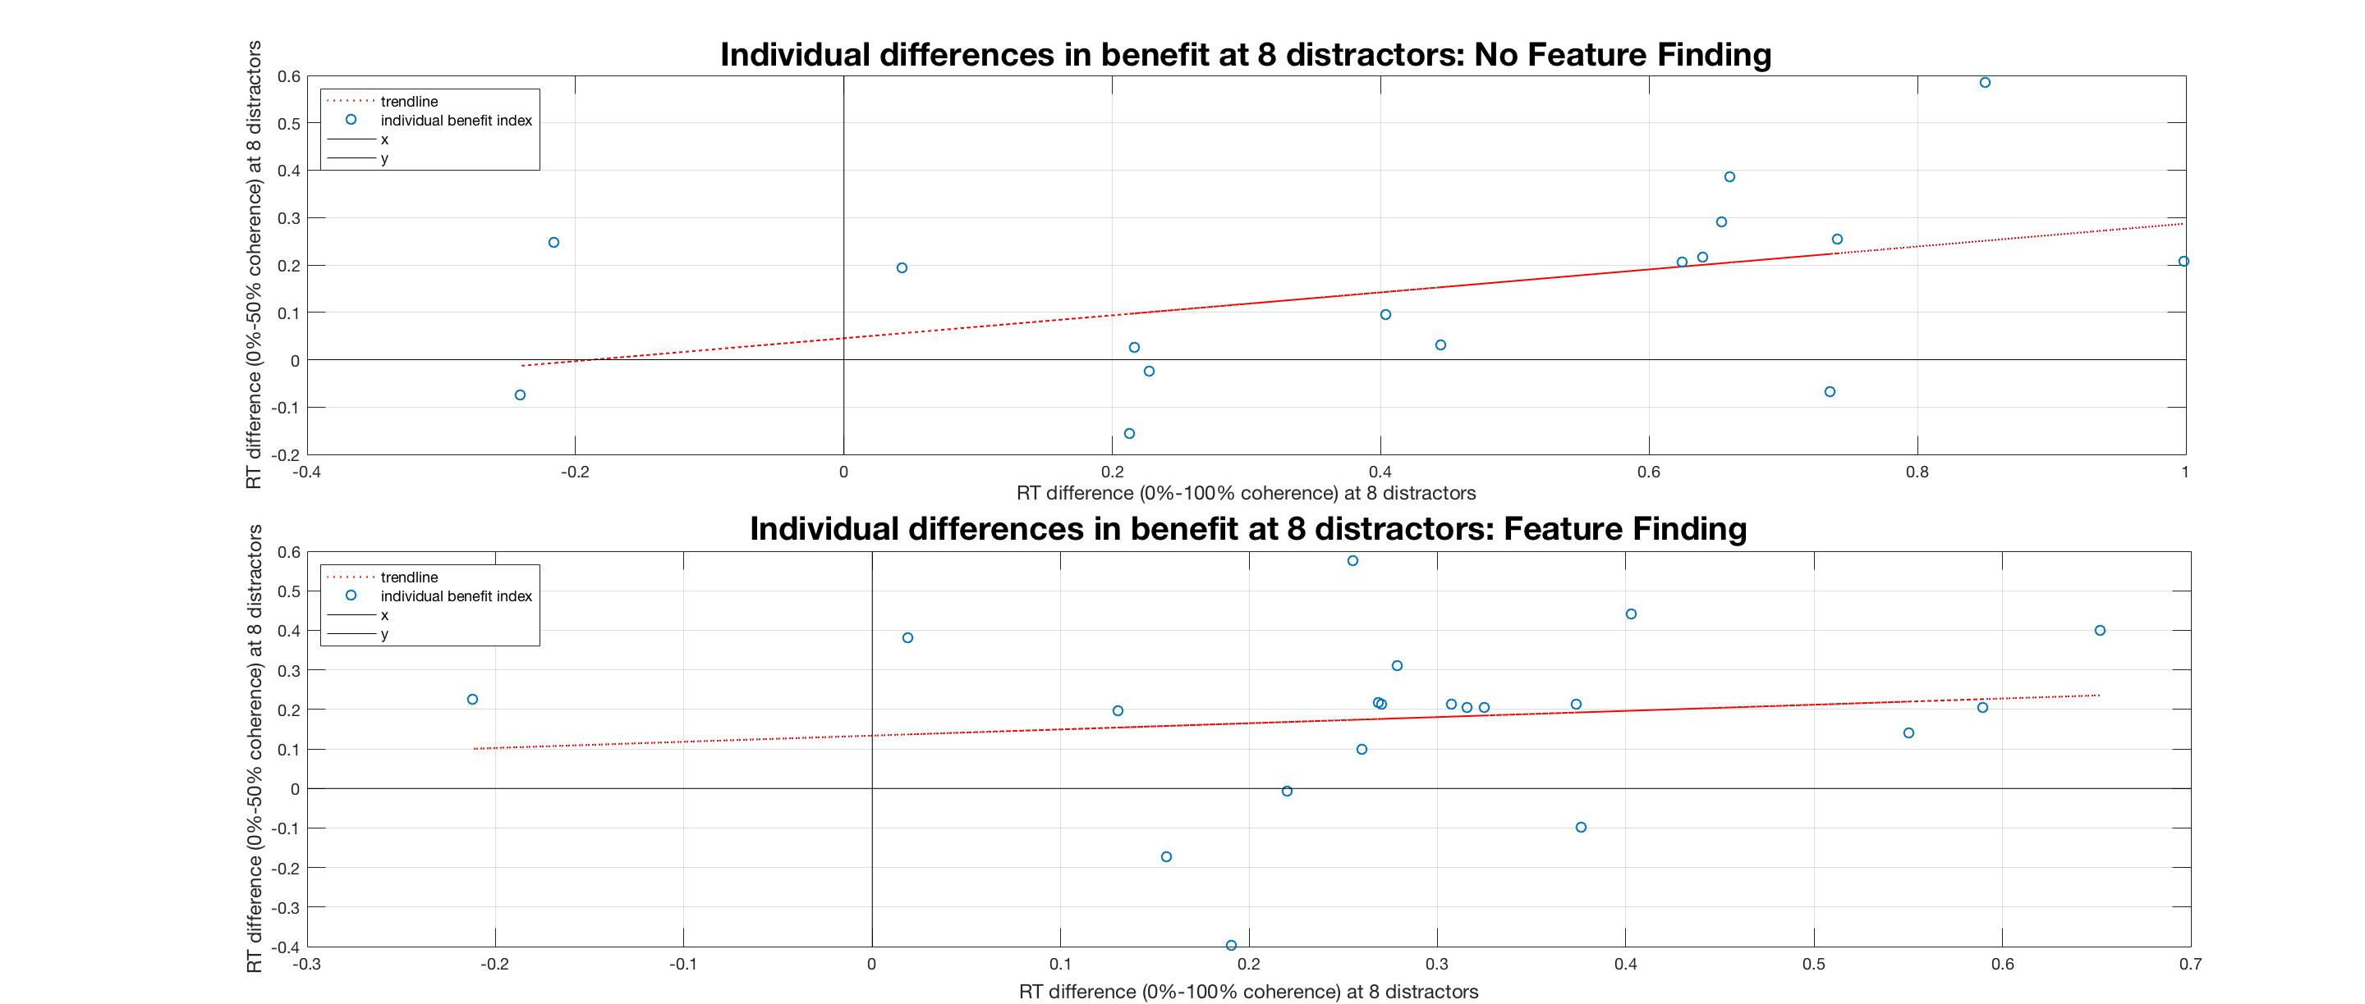

Slide 55
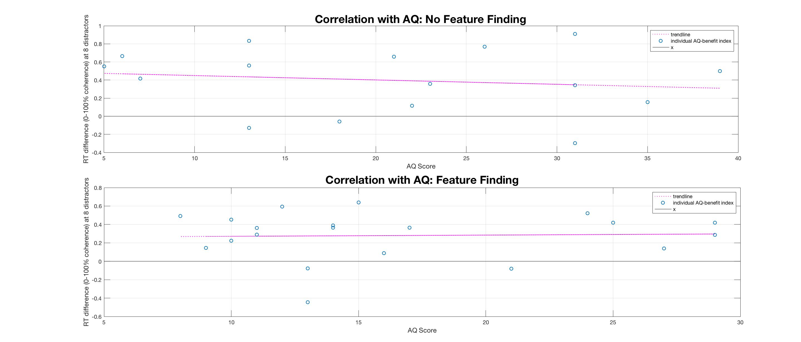
wo

Slide 56
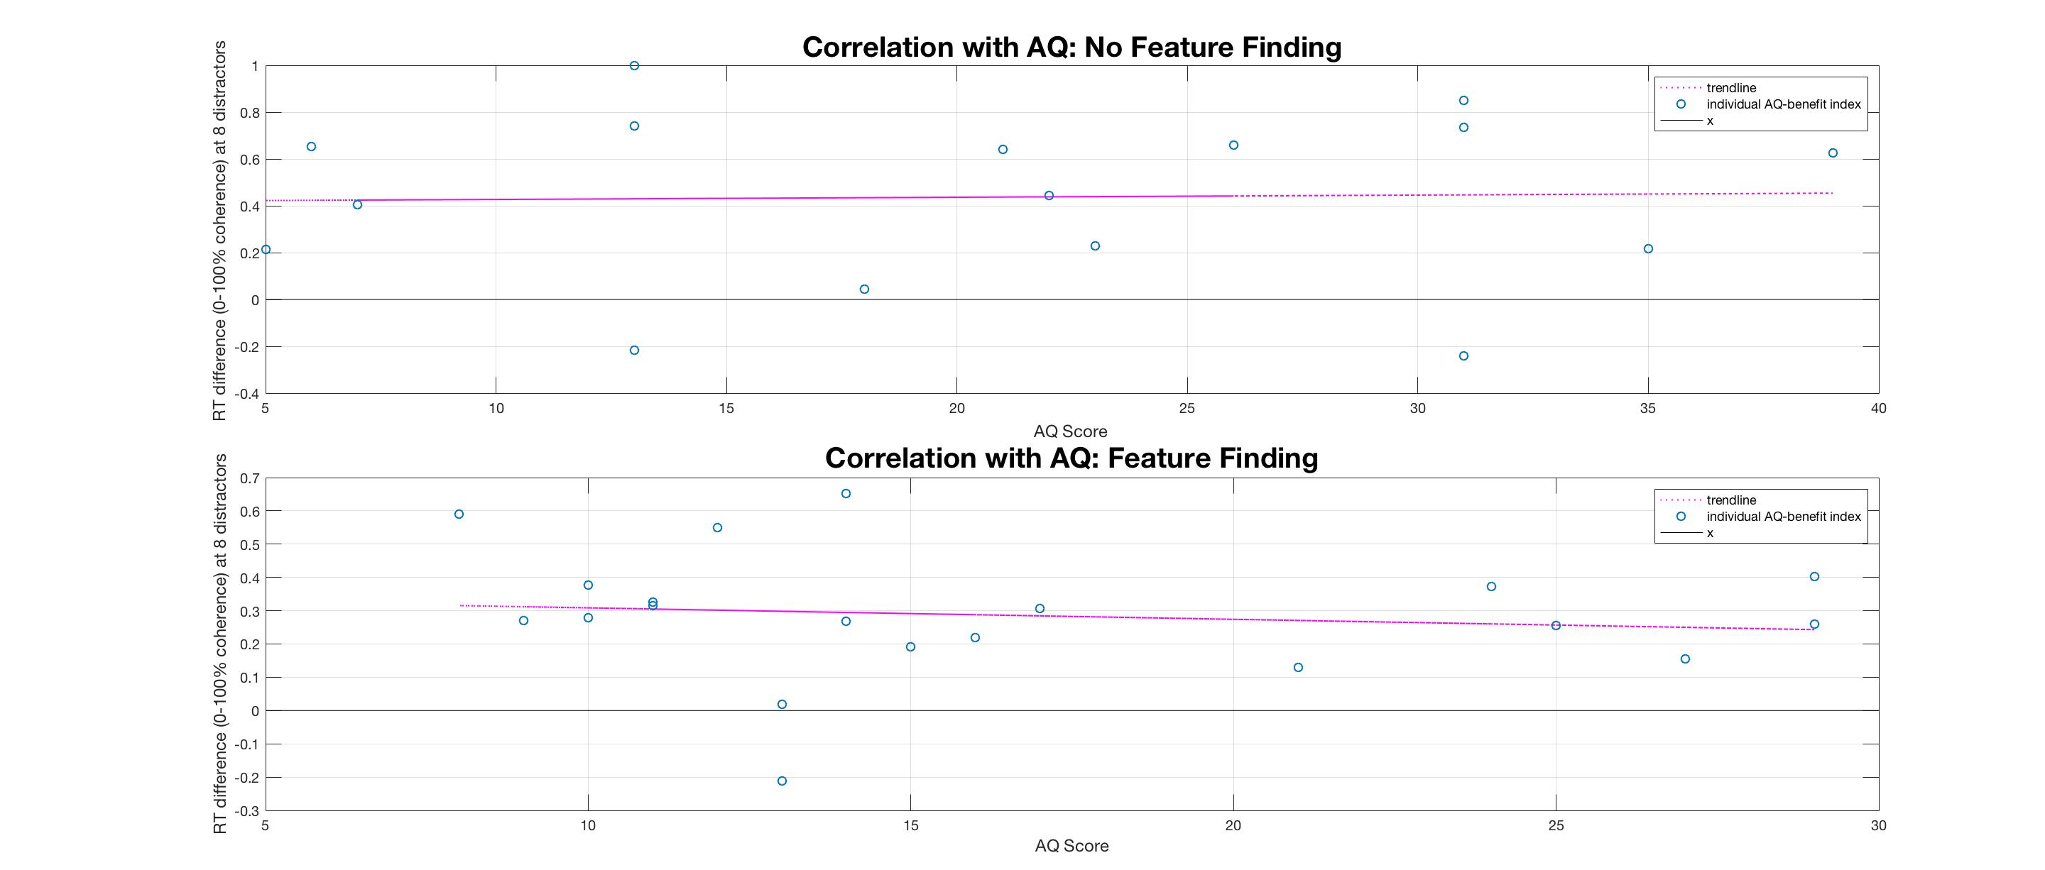

Slide 57
Position Memorization
Without the 1st block
&
Full set

Slide 58
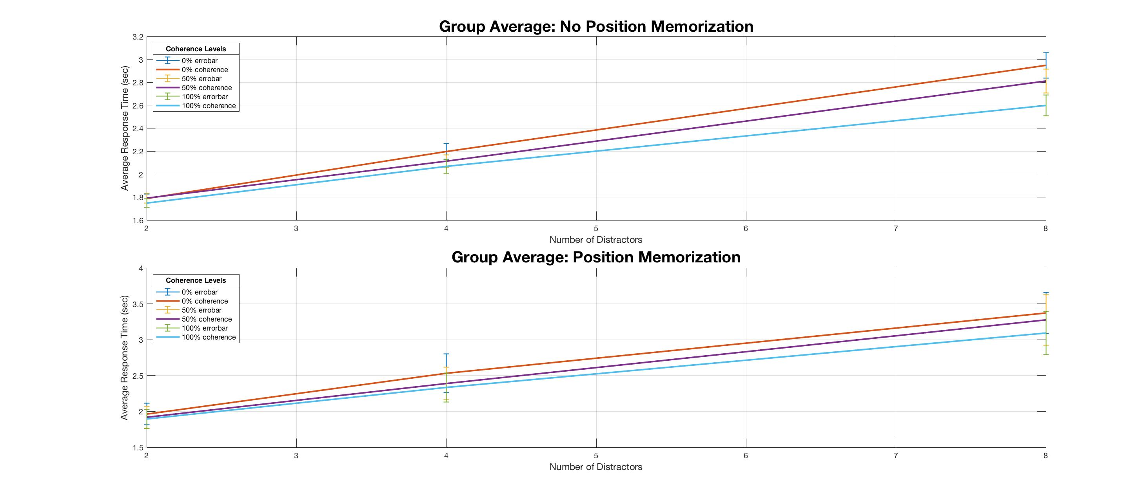
wo
No.: 27
Memo.: 9

Slide 59


Slide 60

wo

Slide 61


Slide 62

wo

Slide 63


Slide 64

wo

Slide 65


Slide 66
Serial Search
Without the 1st block
&
Full set

Slide 67

wo
Not.: 24
Pattern.: 12

Slide 68


Slide 69

wo

Slide 70


Slide 71

wo

Slide 72


Slide 73

wo

Slide 74


